Slide 1
Behavioural Finance
10. How to apply behavioural insights in public policy II
Antonio Silva, May 2023

Slide 2
Behavioural insights project simulation
Each group will work to apply behavioural insights to a real challenge and come up with a behaviourally-informed solution to that challenge
Pick a behaviour to focus on (this can be the topic of your essay)
Your ideas should be:
Feasible (can your idea be implemented?)
Impactful (will it have a social impact?)

Slide 3
Target phase
TARGET
EXPLORE
SOLUTION
TRIAL
SCALE
Phases
Define your goal, scope and measurable behaviours and outcomes.
Notes:
PURPOSE:
Introduce Target phase of methodology
KEY MESSAGE:
The first step in conducting a successful BI project is to clearly define a goal and to understand the behaviours that you want to change to achieve this goal and what outcome you will measure.
TIMING:
1 min
LINK:
To next slide

Slide 4
Identify a high level goal
Notes:
PURPOSE:
The first step of Target is to agree a high level goal to work on
TIMING:
10 sec

Slide 5
Behavioural insights project simulation
Policy challenges - how might we use behavioural insights to...
Improve recruitment outcomes for older workers (aged 50+)
Notes:
PURPOSE:
There is one policy challenge that we would like you to work on over the course of this programme.
KEY MESSAGE:
Mention that they could narrow these down further if they feel they need to
TIMING:
2 mins
LINK:
To next slide

Slide 6
Define measurable behaviours
Notes:
PURPOSE:
The next step in the methodology is identify which behaviours produce the outcome we want to see
Line up audience for next few slides which go through why we focus on behaviours
KEY MESSAGE:
Now that we have the high level goal we need to define a measurable beahviour. To do this, we need to identify who contributes to this goal and what specific behaviours contribute to the success or failure of the goal.
TIMING:
30 seconds
LINK:
To next slide

Slide 7
Why do we focus on behaviours?
Changes in attitudes and beliefs are important,
but they may not go along with changes in behaviour.
Notes:
PURPOSE:
Explain the importance of focusing on behaviours
KEY MESSAGE:
We now want to explain the importance of focusing on “behaviour.”
We are interested in what people actually do.
Changes in stated attitudes, beliefs, and intentions are important, but they may not go along with changes in behavior.
How many of you believe healthy eating is important?
How many of you have eaten unhealthily in the last year?
The same can apply to many things - e.g. smoking, work-life balance, alcohol consumption, time scrolling social media / screen time
TIMING:
1 min
LINK:
To next slide

Slide 8
Identifying specific behaviours you want to change
Believing walking is important
This is an attitude, not a behaviour
Walking in the park every evening
Yes, this is a behaviour - but how would you measure it?
Engaging with community support groups
Engaging is not a specific behaviour
Reporting fire safety concerns
What data sources could you use to measure it?
Taking medication daily
What data sources could you use to measure it?
Losing weight
This is not a behaviour
Feeling less anxious
This is not a behaviour
Notes:
PURPOSE:
Interactive activity to get the audience used to identifying behaviours and to get them to start thinking about how they might measure a behaviour.
WHAT TO DO:
Read each sentence aloud and then ask the audience is this a behaviour? Show them the answer.
KEY MESSAGE:
Beware of the word Engagement - it's not a measurable behaviour change. Each behaviour should start with a verb.
Don’t confuse outcomes with behaviours.
TIMING:
2 min
LINK:
To next slide

Slide 9
Define measurable outcomes
Notes:
PURPOSE:
The next step in the methodology is identify a measurable outcome we can use to determine the impact of an intervention
Line up audience for next few slides which go through why we focus on measurable outcomes
KEY MESSAGE:
Now that we have the high level goal and a measurable behaviour, we need to identify outcomes related to our high level goal and our behaviours that are measurable, specifically it must be observable
TIMING:
30 seconds
LINK:
To next slide

Slide 10
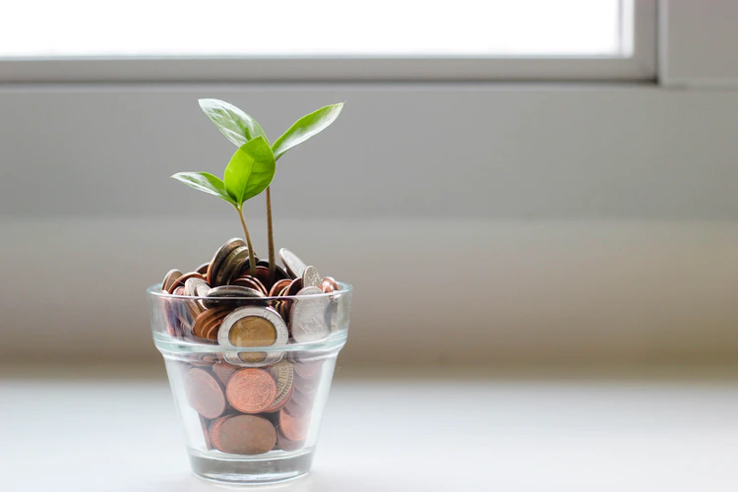
Why do we emphasise behaviours that are directly observable?
People often do not correctly remember what they have done or why they have done it.
Notes:
PURPOSE:
Explain the importance of focusing on behaviours
KEY MESSAGE:
And we emphasize direct observation because of the problems with people reporting their own behavior. People often do not correctly remember what they have done or why they have done it.
When you ask people why they save for a pension they will give reasons such as - because I care about my future. Very few will say ‘because it was the default’.
TIMING:
1 min
LINK:
To next slide

Slide 11
Why do we emphasise behaviours that are directly observable?
People often do not accurately predict what they are going to do.
Notes:
PURPOSE:
Explain that people often inaccurately predict what they are going to do (e.g. they say they’ll go to the gym during the week but end up watching netflix)
KEY MESSAGE:
People often inaccurately predict what they are going to do.
This may be partly driven by the desire to maintain a positive self-image. Even if they have such knowledge, they may tailor their reports to reflect what they think is socially desirable or what a researcher wants to hear.
For example, one national study asked adults to recall how much physical activity they had done over the previous month. A smaller group of those who responded also wore an accelerometer for the week following the survey. An accelerometer directly measures how much people move. When self-reporting, 39 percent of men and 29 percent of women said that they achieved the minimum recommended level of physical activity. But the data from the accelerometers showed that only 6 percent of men and 4 percent of women had done this in reality.
TIMING:
1 min
LINK:
To next slide

Slide 12
Activity 1: Identify measurable outcomes
5 mins
Choose a high level challenge or goal
Reduce antimicrobial resistance
Define target behaviours
“If only x would do y”
GPs stop writing unnecessary prescriptions and use delayed prescriptions when appropriate
Identify measurable outcomes
“We will achieve z”
Reduction in number of antibiotics dispensed
Notes:
PURPOSE:
Get people to pick one behaviour to focus on and define a measurable outline
KEY MESSAGES:
Now that you have identified multiple actors and behaviours that influence your high level goal, you need to pick one actor and one behaviour to focus on and to define a measurable outcome (i.e. what you hope you achieve).
TIMING:
3 min
LINK:
To next slide

Slide 13
Activity 2: Make your target behaviour SMART
5 mins
After you’ve selected a target behaviour, refine the behaviour and measurable outcome to ensure they meet SMART criteria.
Specific: Identify a specific behaviour that you are trying to change
Measurable: Specify a quantifiable outcome measure
Identify direction and expected magnitude of effect.
Assignable: Specify whose behaviour you are trying to change
A specific group or subset or an entire population?
Realistic: Be honest upfront about what is desirable but conscious of the baseline and what may be possible.
Time-Related: Specify when the result(s) can be achieved.
Can the timeframes be linked to existing processes.
Original target behaviour and measurable outcome:
A reduction in doctors prescription rates
SMART target behaviour and measurable outcome:
A 2% reduction in prescription rates across the top 20% of prescribing GPs in the UK within the first 6 months of our intervention
Notes:
PURPOSE:
Introduce SMART
KEY MESSAGES:
Before the EXPLORE phase you may want to refine your target behaviour and measurable outcome
The goal is to get more specific
We use SMART criteria to assess the behaviour and outcome against
Explain each element of SMART
Explain that for the sake of the simulation, we'll conduct this exercise at one point in time; however, in reality the refinement of your target behaviour, population, anticipated effect size, timeframe and your assessment of what is "realistic" will change as more information about the challenge becomes available, particularly in the Explore phase.
TIMING:
2mins
LINK:
To next slide

Slide 14
Explore phase
TARGET
EXPLORE
SOLUTION
TRIAL
SCALE
Phases
Understand the context and perspective of the end-users
and the barriers to performing a target behaviour.
Notes:
PURPOSE
Introduce Explore. E
KEY MESSAGE:
“The next phase of a BIT project is the Explore phase.
The aim of the explore phase is to really understand the target behavior in its context and to identify the drivers of this behaviour.
TIMING:
30 seconds
LINK
To next slide

Slide 15
Literature Review
Involves: Looking at published articles to see if other rigorous experiments have successfully addressed similar challenges.
Benefits
Helps you to build on pre-existing findings.
Allows you to understand if and how other people have tried to tackle the same problem in the past
Can offer evidence of what people actually do rather than what they say that they do.
Example finding: At least 20% of antibiotic prescriptions in primary care are inappropriate.
Source: Department of Health and Social Care, 24 January 2019, UK 20-year vision for antimicrobial resistance, page 6, Figure 2. Antimicrobial resistance in the UK: a snapshot.
Notes:
PURPOSE:
Introduce literature reviews as a tool used in the Explore phase
KEY MESSAGE:
We look at the literature and behavioural models to understand if other people have tried to tackle the same problem in the past and to understand what might be the drivers of our target behaviour.
So for example we might find published studies looking at why some GPs overprescribe antibiotics
TIMING:
1 min
LINK:
To next slide

Slide 16
Data Analysis
Involves: Looking at data to find relationships, patterns, and trends.
Benefits
Helps you identify the key aspects and scale of a problem.
Helps us to inform how we might tackle the problem and where we should focus our efforts.
Can offer evidence of what people actually do rather than what they say that they do.
Example finding: 1 in 3 individuals in England takes at least one course of antibiotics each year.
Source: Department of Health and Social Care, 24 January 2019, UK 20-year vision for antimicrobial resistance, page 6.
Notes:
PURPOSE:
Introduce data analysis as a tool used in the Explore phase
KEY MESSAGE:
We look at existing data to identify patterns that can help us better define the problem. For example, we might find that antibiotics are only overprescribed in some very specific practices or at some specific times of the day.
What we did for the antibiotic prescription project was to look at the data where we found that some practices were consistently overprescribing antibiotics which helped us to inform how we might tackle the problem and where we should focus our efforts.
We can, for example, evidence how widespread a behaviour is, who is performing it, and the trend over time.
TIMING:
1 min
LINK:
To next slide

Slide 17
Observations
Involves: Observing the way that people interact with stimulus materials.
Benefits
First-hand evidence of how people navigate an environment, rather than self-reports of how they think they behave.
Unfiltered access to people’s initial reactions, emotions and micro-behaviours (e.g. hesitations, facial expressions).
Demonstrates how a system or process works in practice, rather than how we think it works.
Example finding: Some GPs prescribed antibiotics to patients who insisted on receiving them, even if the GP did not initially advise that they were needed.
Notes:
[Run through points in the slide]
I’m going to include mystery shopping in this category, too. It’s a forensic observation of a process, conducted by the researchers themselves.
We can test drive a reporting process, noting our thoughts, missteps, points which are unclear etc.

Slide 18
Interviews
Involves: Asking questions to verbally elicit people’s views, attitudes and knowledge.
Benefits
Allow us to understand people’s experiences and viewpoint, including their explicit interpretations and understanding of events.
New ideas and concepts are generated through the interaction between the researcher and participant, and in-depth exploration that occurs.
Example finding: GPs have no awareness of how their own rates of prescribing antibiotics compare to others in their practice or region.
Notes:
Understanding people’s viewpoints: Mental models are how people make sense of a concept or environment. They’re simplified frameworks for navigating a topic or issue.
Well-structured interviews will tell us a lot about someone’s mental models, e.g. what the first things that come to mind on a topic, the assumptions that people make, and their blind spots. On fraud, for example, people might have particular types of fraud in mind because they know someone else who has experienced it, and think that fraud is something that affects other people, not them.
These findings tell us a lot about someone’s likelihood of performing the target behaviour, and what the obstacles might be to changing that behaviour.

Slide 19
Identify key decision points in the user journey
Notes:
PURPOSE:
Line up introduction to decision maps that can be used to understand the perspective of the end user.
KEY MESSAGE:
We use Decision Maps to identify the key decisions made in a user journey
TIMING:
30 sec
LINK:
To next slide

Slide 20
Creating a decision map
Action
Decision
Decision Maps are a tool you can use to understand the perspective of the end user and to identify the decisions users take at each step of the process.
Actors
Actions and decisions
Appointment After Appointment
Presents symptoms to doctor
Takes to pharmacy
Takes medication
1
How to present symptoms
4
Whether to fill the prescription
6
Patient
Whether to comply with instructions
Assess patients
Writes a prescriptions
Clarifies if there are questions
Doctor
2
3
How to interpret symptoms
Whether to prescribe antibiotic or not
Fills prescriptions
Whether to query the prescription
Pharmacist
5
Notes:
PURPOSE:
Line up introduction to decision maps as a tool that can be used to understand the perspective of the end user.
KEY MESSAGE:
We use Decision Maps to identify the key decisions made in a user journey
First we identify your swimlanes for the decision map. We have one swimlane for each actor / stakeholder who is involved in the process.
Then we outline the steps taken at each stage of the process
And finally you need to document the decisions that are made at each step (e.g. whether to comply with antibiotic instructions)
TIMING:
4 mins
LINK:
To next slide

Slide 21
Identify barriers to behaviours and decisions

Slide 22
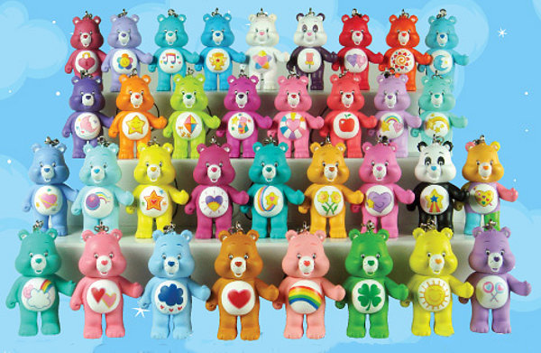
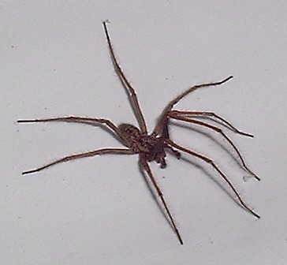
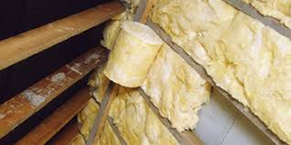
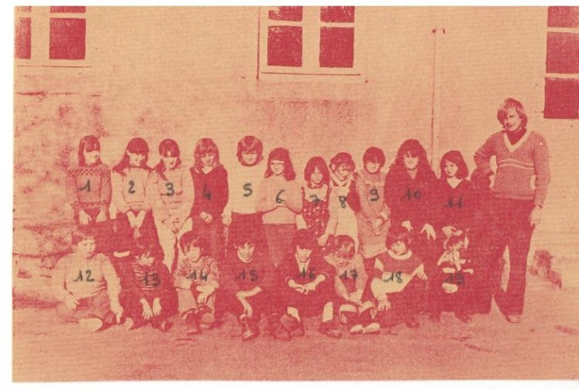
Identifying what is preventing the target behaviour
Notes:
PURPOSE:
Highlight the importance of identifying barriers
KEY MESSAGE:
A trial we ran with Dept of Energy & Climate (name of dept in UK at the time) focussed on increasing the number of people who insulated their attics.
People understand the benefits of insulation in lofts but don't do it. We thought it might be future discounting (since the cost is up front and the benefit delayed) but…
The explore work showed that people view the attic as something overwhelming: they have memories they've not looked at for years in there, there's all kinds of junk they don't want to think about... and then there's the spiders.
A pilot study suggested that a more expensive service which includes help to clear the attic is more attractive.
The point here is that without this explore work a solution might have centred on making the service cheaper - but cost wasn’t the real barrier to the behaviour.
This illustrates the importance of the explore phase in diagnosing the real barriers to behaviour
TIMING:
2 mins
LINK:
To next slide

Slide 23
Identifying what is preventing the target behaviour
COM B Model
Capability
Opportunity
Target Behaviour
Motivation
Source: Michie, S., van Stralen, M. M., & West, R. (2011). The behaviour change wheel: a new method for characterising and designing behaviour change interventions.
Notes:
PURPOSE:
Introduce COM B model as a behaviour change framework we use to identify barriers to behaviour
KEY MESSAGE:
The COM-B model is a theoretical model which aids understanding of the barriers and facilitators of behaviour.
If one or more of these 3 factors are deficit then it is less likely behaviour change will occur.
Capability refers to the skills or mental processes required to perform a behaviour
Opportunity refers to the physical and social environment that enables the behaviour
Motivation refers to the cognitive processes that drive the behaviour including both conscious and non-conscious decision making.
TIMING:
2 mins
LINK:
To next slide

Slide 24
Identifying what is preventing the target behaviour
Capability Barriers
Opportunity Barriers
Motivational Barriers
Physical ability | Do I have the physical ability to do it?
Awareness | Am I aware of the options available to me?
Know how & cognitive skills | Do I understand it? Do I know how to do it?
Interpersonal skills | Do I have the interpersonal skills to do it?
Memory | Will I remember to do it?
Attention span | Will it capture and hold my attention? Will I get bored halfway through?
Evaluating options and making decisions | Will I be able to evaluate the different options and make the right decision?
Opportunities in the environment | Are there opportunities in the environment to do it? Does the environment make it difficult or impossible?
Prompts in the environment | Does the environment encourage or discourage it?
Resources and time | Do I have the resources and the time needed to do it?
Social and cultural norms | Is it the norm in my social group to do it? Will I be perceived negatively if I do it? How do my peers influence my behaviour?
Role models | What role models in my environment will encourage me to do it?
Belief in abilities | Do I believe I can do it?
Beliefs about consequences | Will it lead to a positive or negative outcome? Is this outcome likely to happen? Will it have a significant impact?
Goals | Have I got a clear goal or target? Is the goal a priority for me?
Identity | Is the behaviour in line with how I see myself?
Negative emotions | How do I feel when I do it? How do I feel about doing it?
Unhelpful habits | Is the behaviour a habit?
Accountability | Who will hold me accountable?
Automatic responses | Do I do it without realising? Is it an automatic response that happens outside of my conscious awareness?
Notes:
PURPOSE:
Talk through some common barriers - don’t talk through all of them, give a few examples from each category
KEY MESSAGE:
Here are some examples of different types of behavioural barriers within each category.
Don’t worry about writing all of these down we’ll give you some cards / show you a tool soon to use which outlines all of these examples.
TIMING:
3 mins
LINK:
To next slide

Slide 25
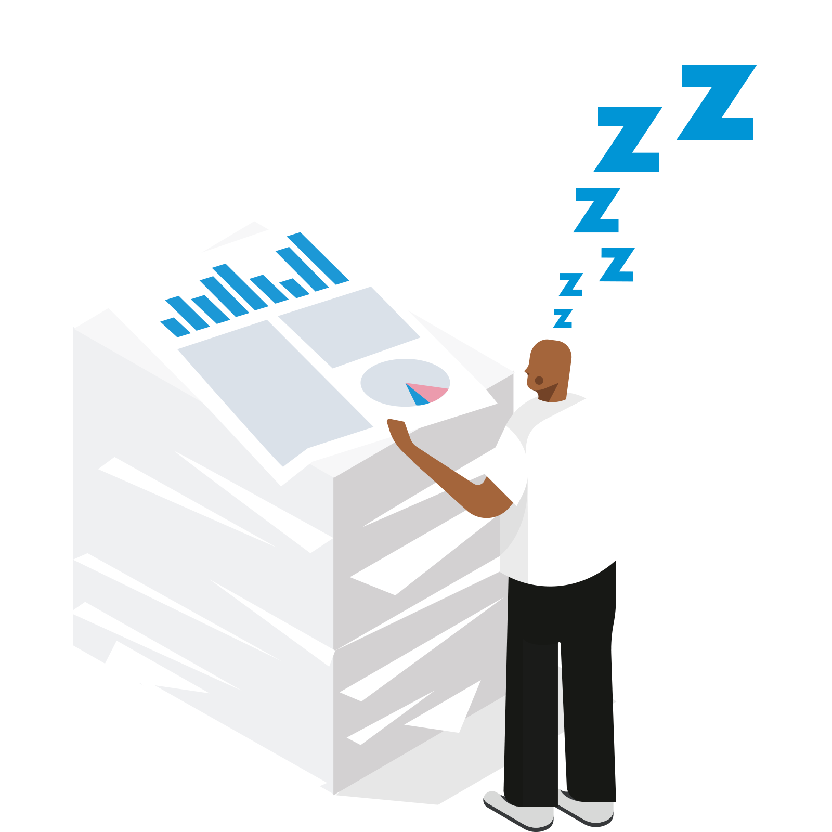
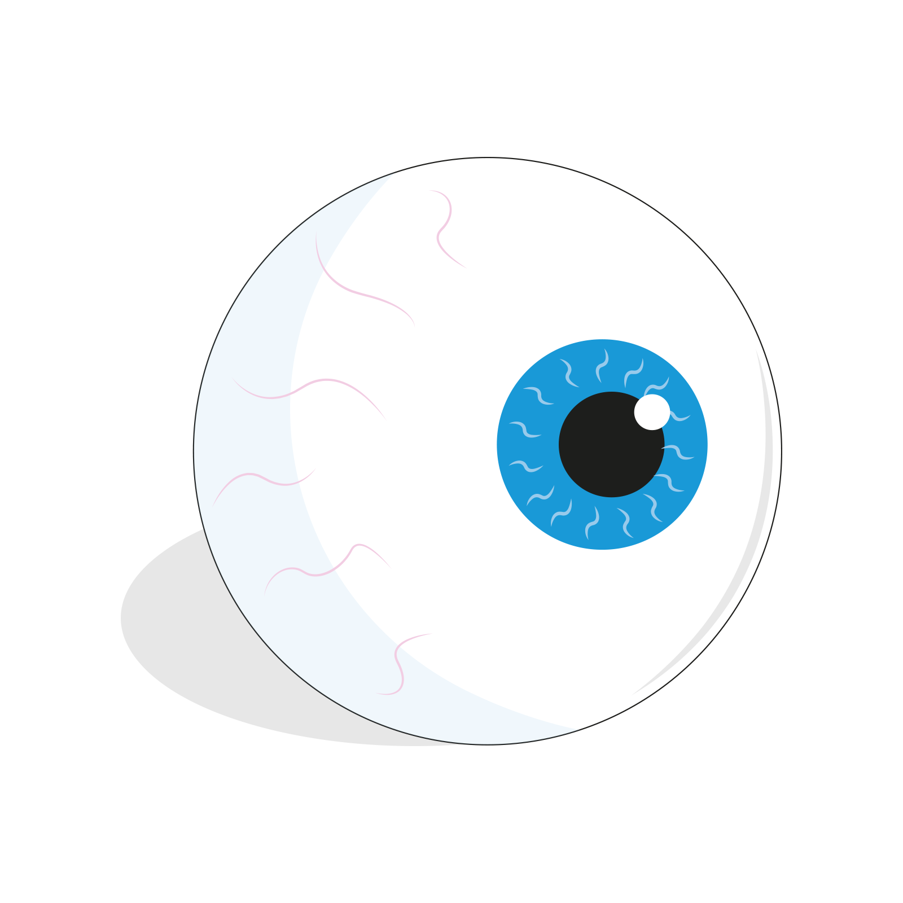
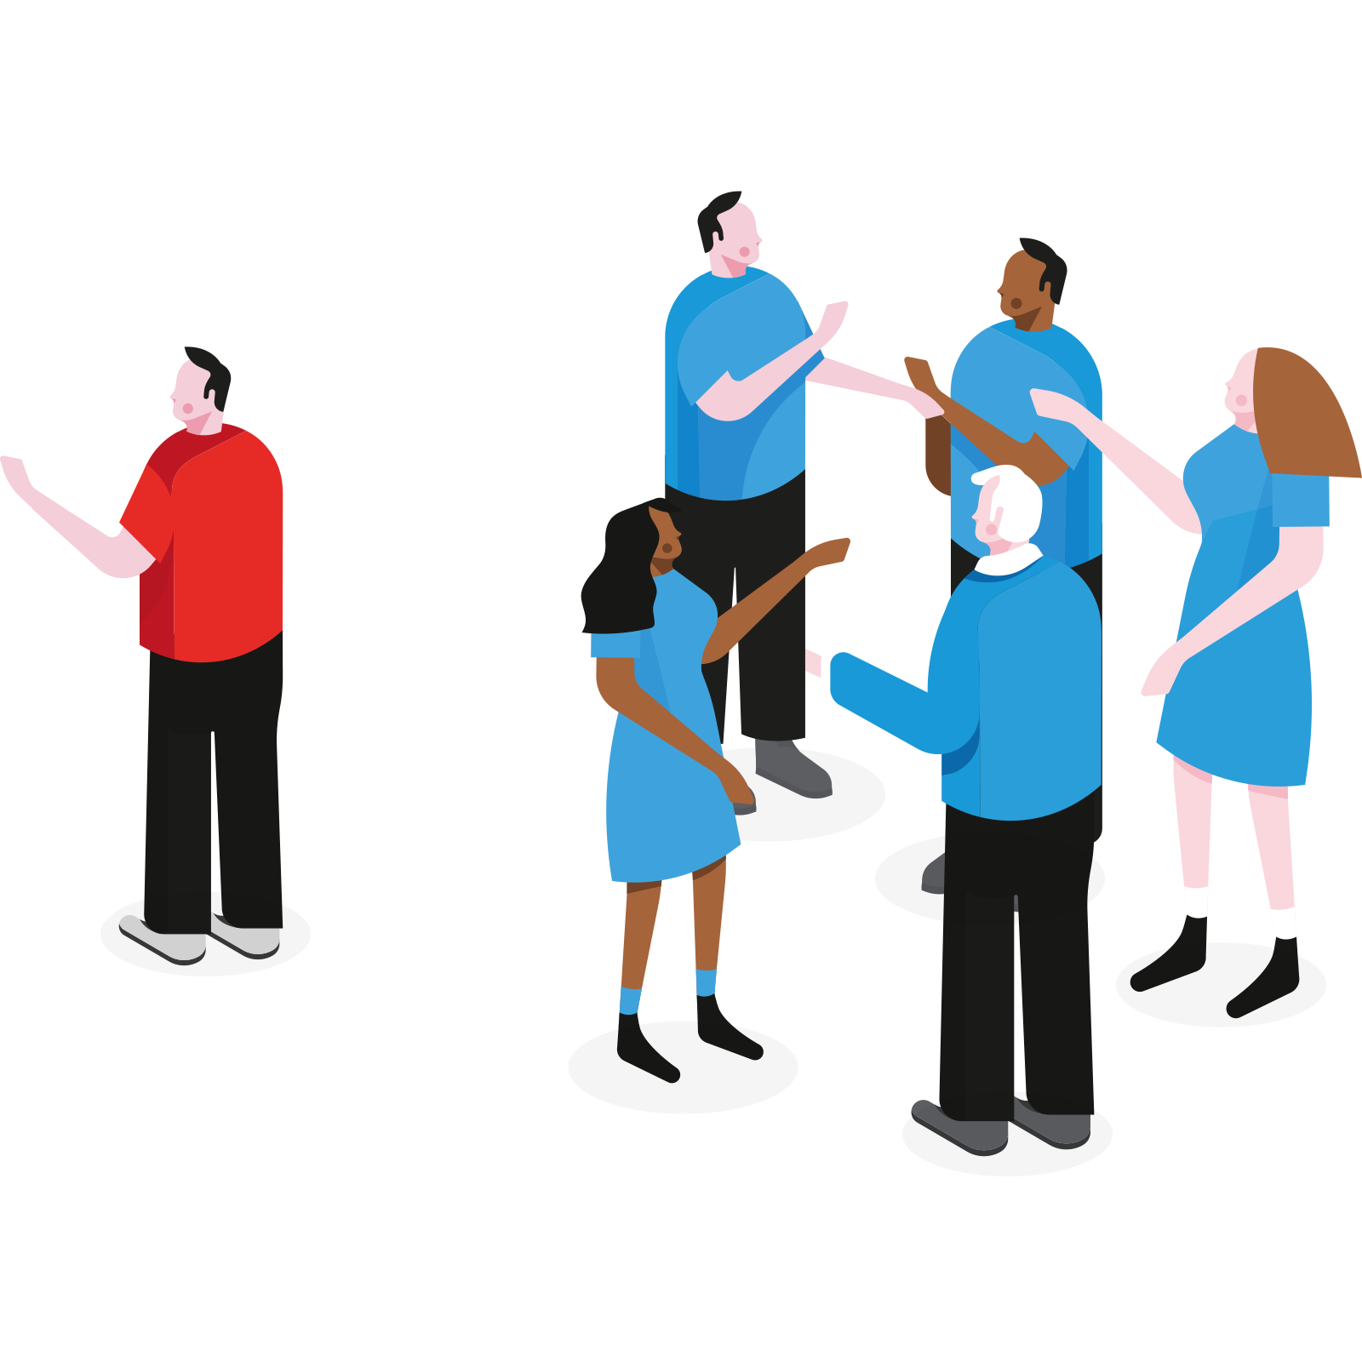
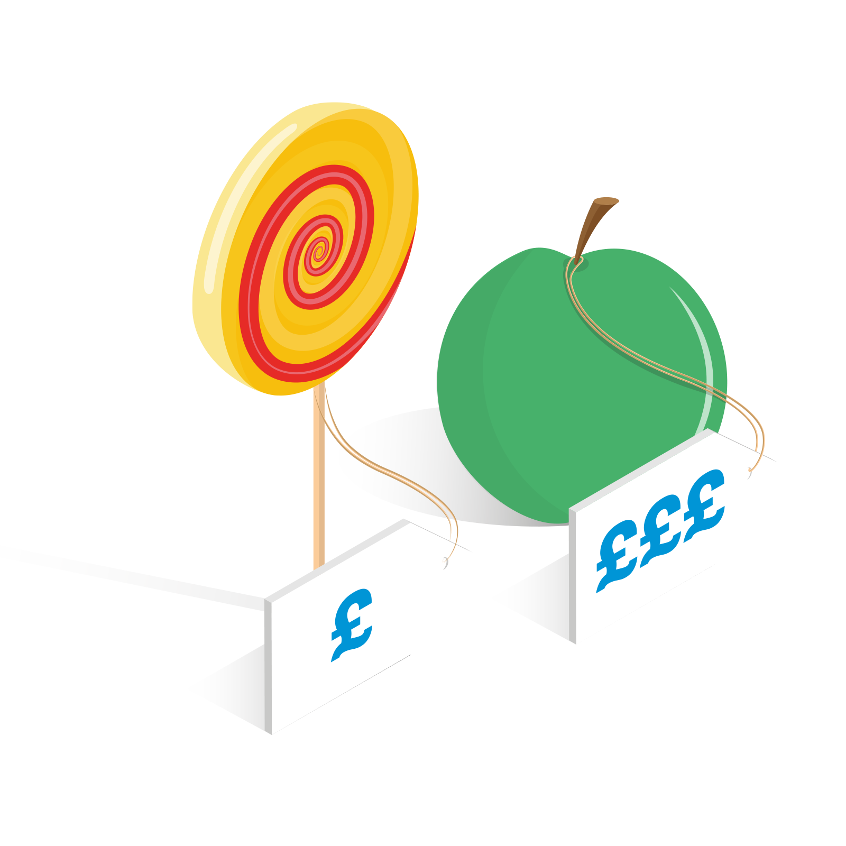
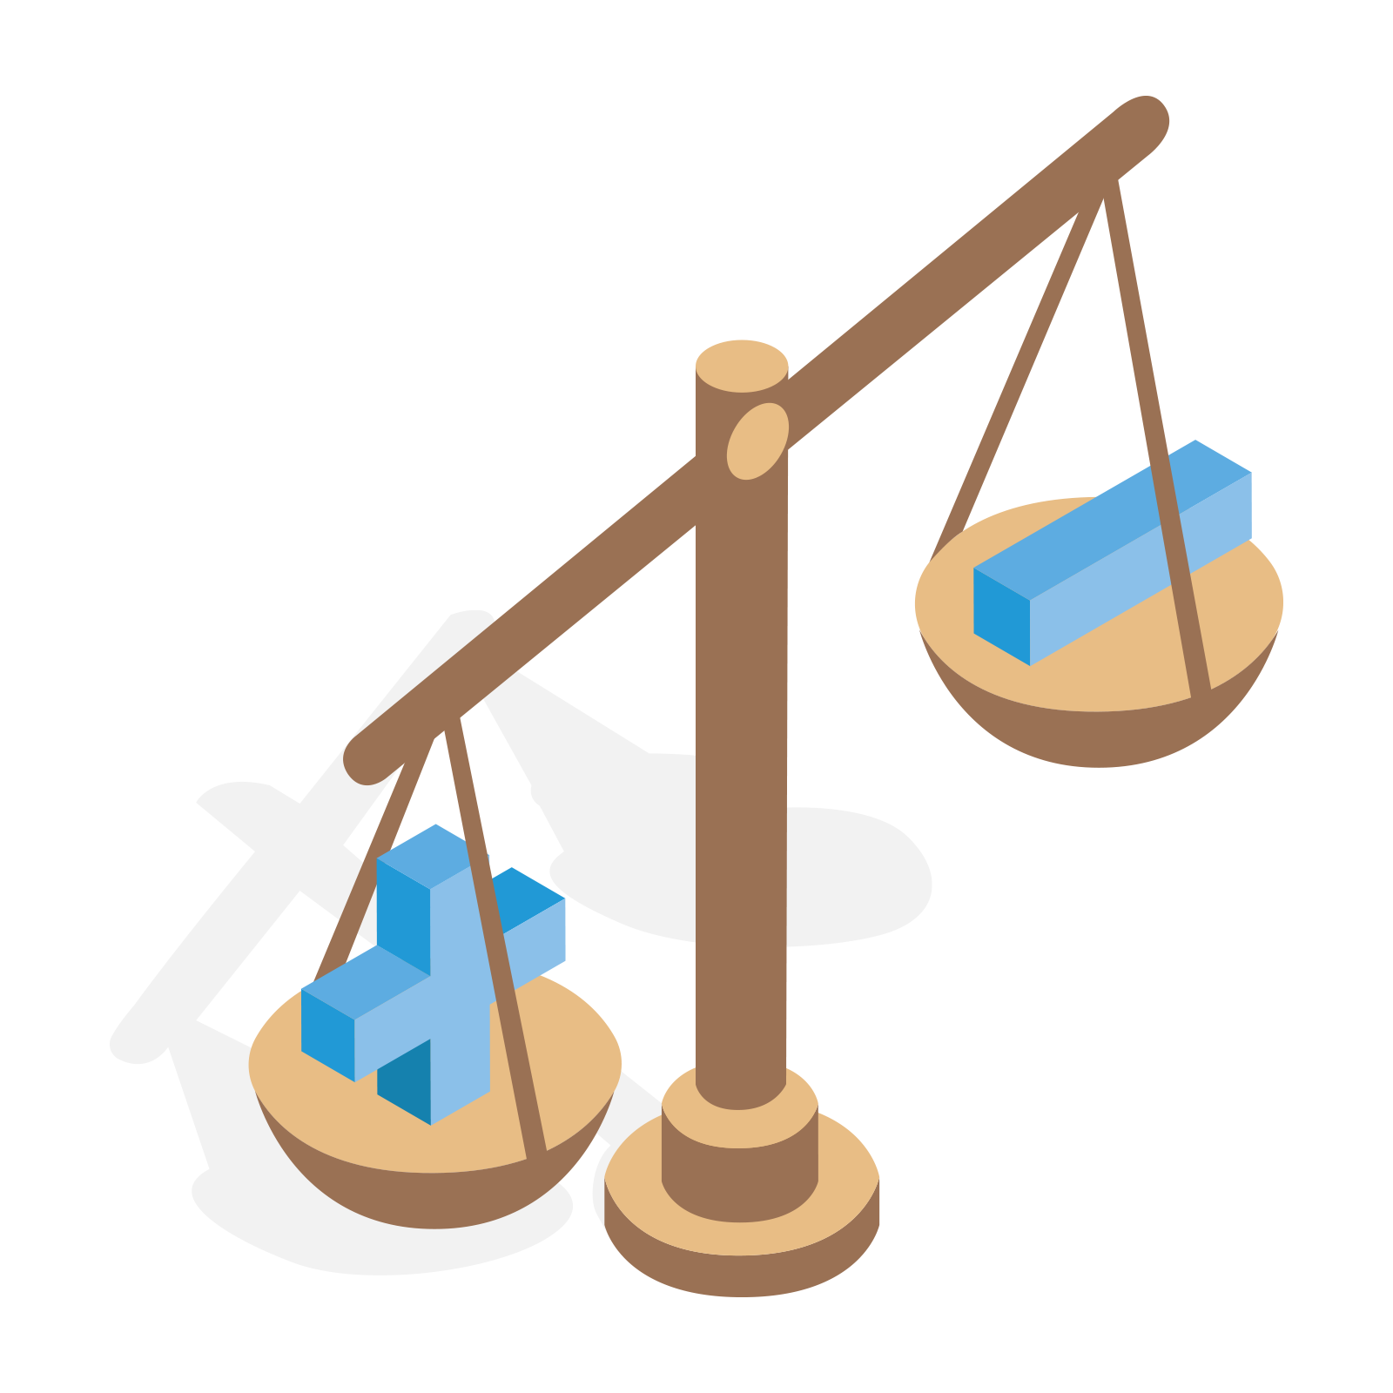
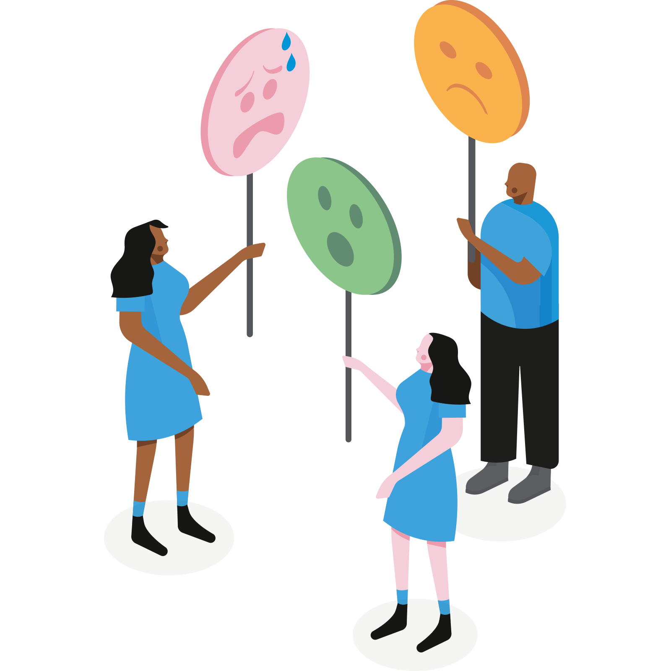
Identifying what is preventing the target behaviour
Behaviour / Decision | Whether to prescribe an antibiotic or offer an alternative.
CAPABILITY
OPPORTUNITY
MOTIVATION
GPs may not have the attention span to consider alternative recommendations.
GPs may not be aware that they are above the norm in terms of prescription rates.
GPs may not have the interpersonal skills or resources to say “no” to a demanding patient.
GPs don’t have the time to consider alternatives options to antibiotics.
Prescribing is a social norm and GPs imagine other doctors would prescribe in similar situations.
There are no prompts in the environment to discourage GPs from writing prescriptions.
GPs want to see as many patients as possible within the day and believe that the consequences of refusing to give prescriptions will make appointments longer and lead to repeat appointments.
GPs write prescriptions as an emotional response to a patient in distress.
Writing prescriptions is a habit for GPs.
Notes:
PURPOSE:
Talk through the different barriers identified in the antimicrobial resistance trial
KEY MESSAGE:
We identified capability, opportunity and motivational barriers that were influencing GPs prescription behaviours
TIMING:
2mins
LINK:
To next slide

Slide 26
Three types of barriers to uptake of free childcare for two year olds
Passive | Proactive | Practical
Unaware of the scheme, eligibility and how to apply Unaware of benefits of nursery in regards child development | Fear of loss and change Fear of negative experience of nursery Cultural or familial beliefs, attitudes, and perceptions | Poor English skills Poor digital skills
Notes:
COM B is not always the answer and there are alternative ways of categorizing barriers - this is an example from a LOPAC project where COM B wasn’t suitable
An alternative way of categorizing barriers when COM-B is not a natural categorisation

Slide 27
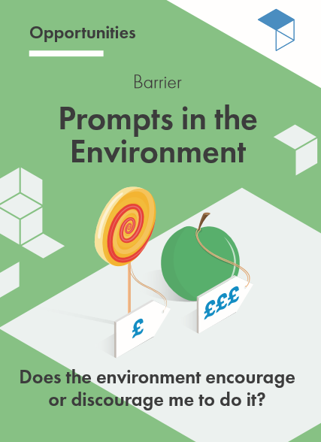
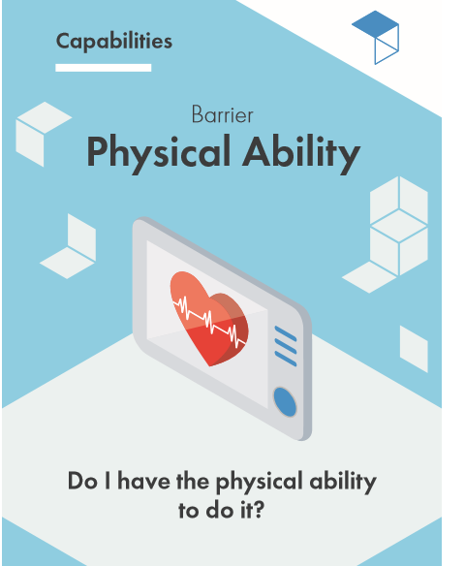
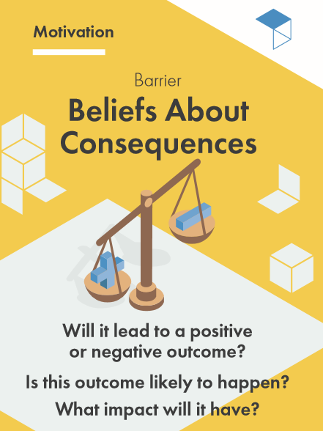
Exercise: Identify barriers to target behaviour
Instructions
Use the digital barrier cards to help you identify and categorise behavioural barriers that may be preventing the target behaviour.
Each card outlines one behavioural barrier and 4 examples of how this barrier impacts behaviour.
What are the capability barriers?
What are the opportunity barriers?
What are the motivational barriers?
Notes:
PURPOSE:
Give instructions for homework exercise - Barrier Cards
KEY MESSAGES:
For homework you will use our BIT Barrier Tool to to identify what barriers are preventing the target behaviour from being performed.
You can use the Behavioural Barrier cards to help you think through and categorise some potential barriers.
Fill out the Barriers section of the workbook to identify the specific barriers and enablers to the behaviours that you want to encourage or discourage
SHOW THEM WHERE YOU WANT THEM TO DO THIS VIA SCREENSHARE
It should not take more than 15 mins
I’ll demo the tool now
WHAT TO DO:
Demo the tool
TIMING:
10 mins
LINK:
To next slide

Slide 28
EASY
Title
ATTRACTIVE
TIMELY
Easy
SOCIAL
Notes:
KEY MESSAGES:
“Starting with easy...” Desire path (above)
TIMING:
30 sec
LINK:
To next slide
TOTAL TIMING FOR EASY
7.5 mins

Slide 29
Making it easy
EASY
Set intelligent defaults
Reduce the
hassle
Simplify
Notes:
KEY MESSAGES:
“To make a behaviour easy, we use:
Defaults
There’s a tendency for people to stick to their pre-selected defaults. For example, when you get a new phone - most likely you will not go through each individual setting and make changes.
We infer that defaults have been carefully chosen and are the best thing for us - they send a signal of legitimacy
Google - preloaded search functions, chrome
Friction Costs or the ‘hassle factor’
Friction cost refers to the amount of effort it takes to complete a behaviour.
For example, there are higher friction costs to filling out the correct tax form that requires you to dig through the website to find it as opposed to being directed straight to the form you need to fill out
The opposite example is how little friction there is to complete a purchase on amazon - usually it only takes a few clicks due to pre-filled forms, auto-complete credit card information, etc. (which might not be a good thing!).
Reducing effort required makes it more likely that people will do something
Simplify
Like I said earlier, people’s attention is limited and in high demand. I am sure we have all had the experience of opening an email only to realise its 2 pages long, and then avoiding responding for longer than you normally would.
Often what needs to be said can be made significantly clearer with the call for action coming at the top of your emails.
Making communications or messages as simple as possible often results in increased response rates to communications.

Slide 30
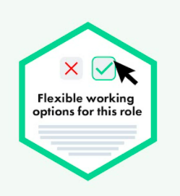
How would you prompt employers to offer more roles with flexible working options? Changing the default
Notes:
PURPOSE:
Share real life, non-BIT, example
KEY MESSAGE:
“Thinking EAST, how would you reduce prescribing errors in clinical setting?”
TIMING:
1 min
LINK:
To next slide

Slide 31
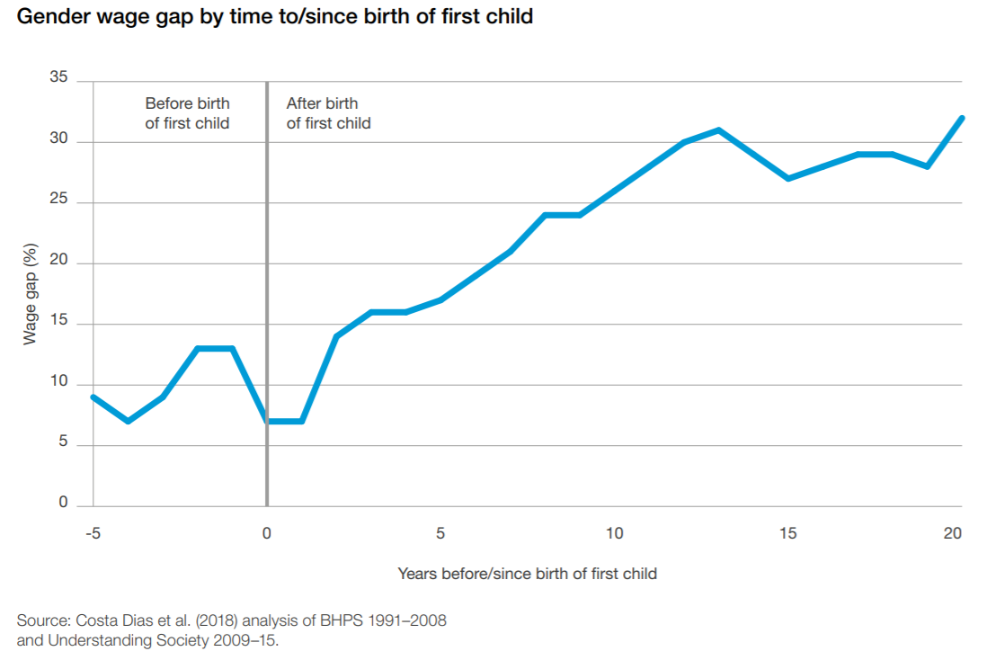
What’s the problem?
At Zurich, part-time staff were 35% less likely to apply for promotions
Notes:
A large driver of the gender gap is due to part-time employees having low or no progression or pay rises compared to full-time colleagues.
Part-time workers are much more likely to be women
Part-time workers have low or no progression compared to full-time colleagues: https://www.ifs.org.uk/publications/10364
Women are 3x more likely to work part time as men: https://www.cipd.co.uk/Images/megatrends-report-flexible-working-1_tcm18-52769.pdf

Slide 32
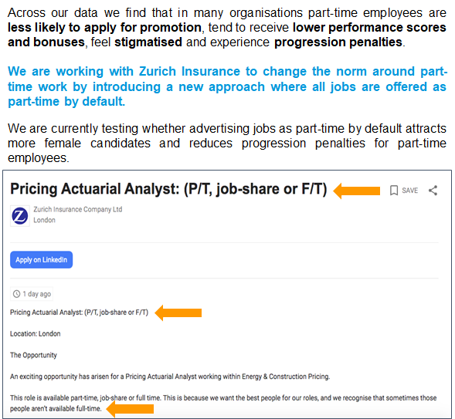
We worked with Zurich Insurance to test advertising all positions as flexible by default
Part-time option highlighted in title and at top of job posting.
Inclusive language added to job posting.
Notes:
Initial quantitative data diagnosis showed that, relative to full-time employees, part-time employees were 35% less likely to apply for promotions, received raises that were 1.1% lower, and received lower scores on performance and potential to progress metrics.
We also conducted interviews with 25 managers and employees at Zurich. These suggested that part-time employees at Zurich lacked clear progression paths – they tended to think they were unable to progress without increasing working hours, often because jobs are not explicitly advertised as being open to part-time work patterns. This, alongside a perceived lack of senior role models, seemed to harm career aspirations.
Our interviews also suggested that there was some stigma around working part-time, related to perceptions of commitment of part-time employees, and employees feared being judged for seeking to reduce their working hours. In addition, managers and employees saw part-time work as a privilege, rather than a right.
Therefore, the intervention focused on normalising flexible working and comprised:
changing the default for advertising all vacancies to be available on a part-time and/or job-share basis
including these options in the job title line and adding an ‘inclusive’ statement
Making training about how to offer flexible roles to hiring managers and other relevant stakeholders

Slide 33
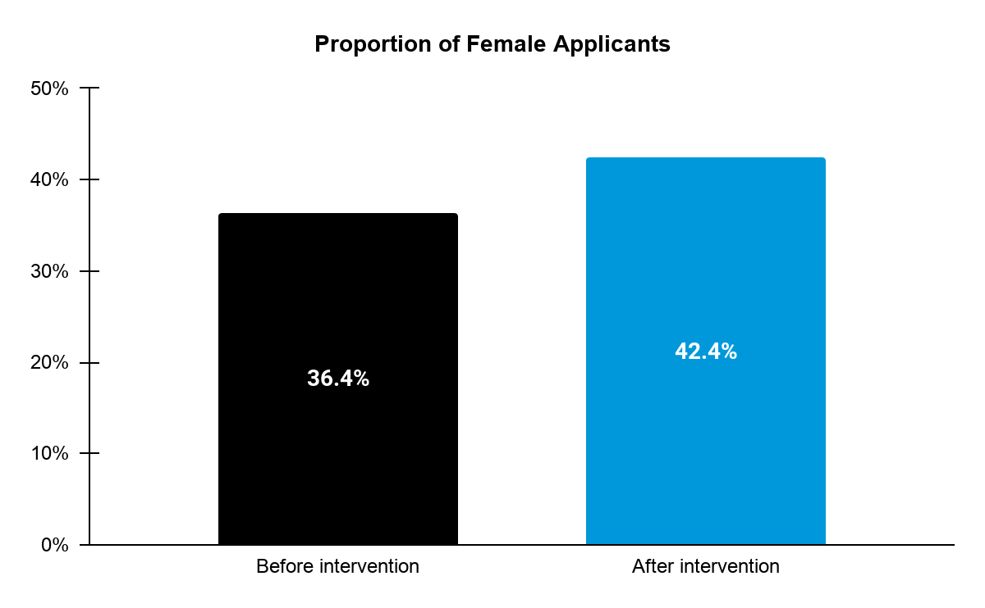
But we found that advertising as flexible by default increased the proportion of female applicants by 16%
6 p.p.
(16%)
**

Slide 34
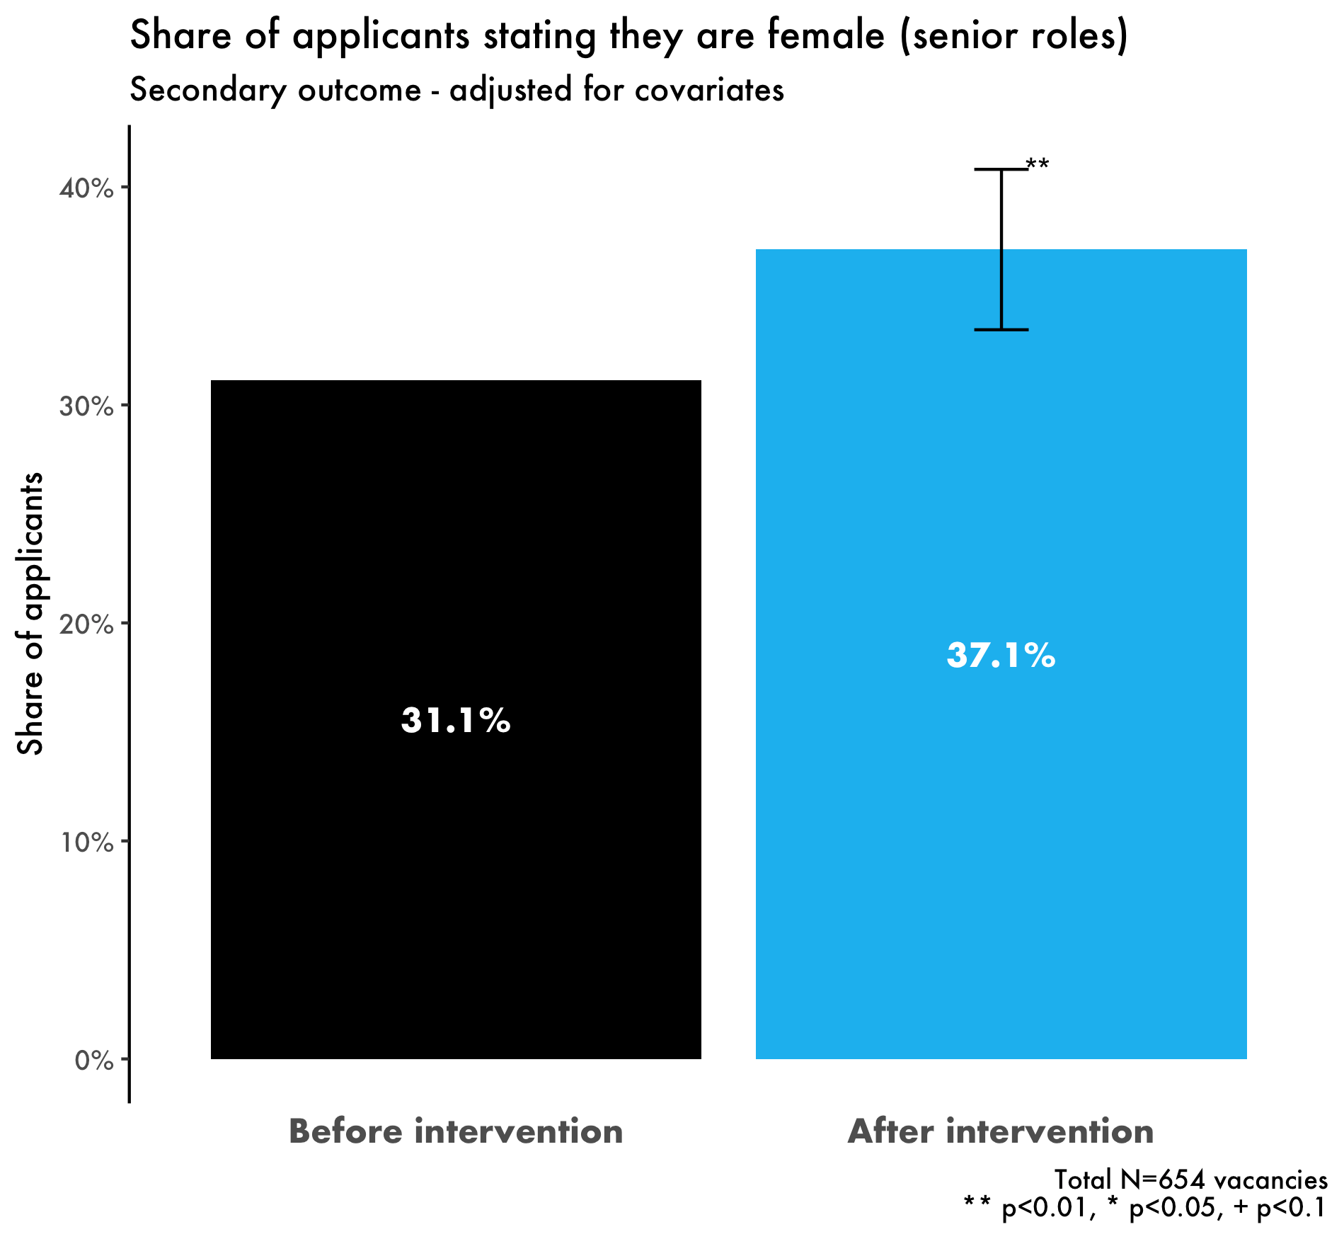
And advertising as flexible by default increased the proportion of female applicants to senior roles by 19%
6 p.p.
(19%)
**

Slide 35
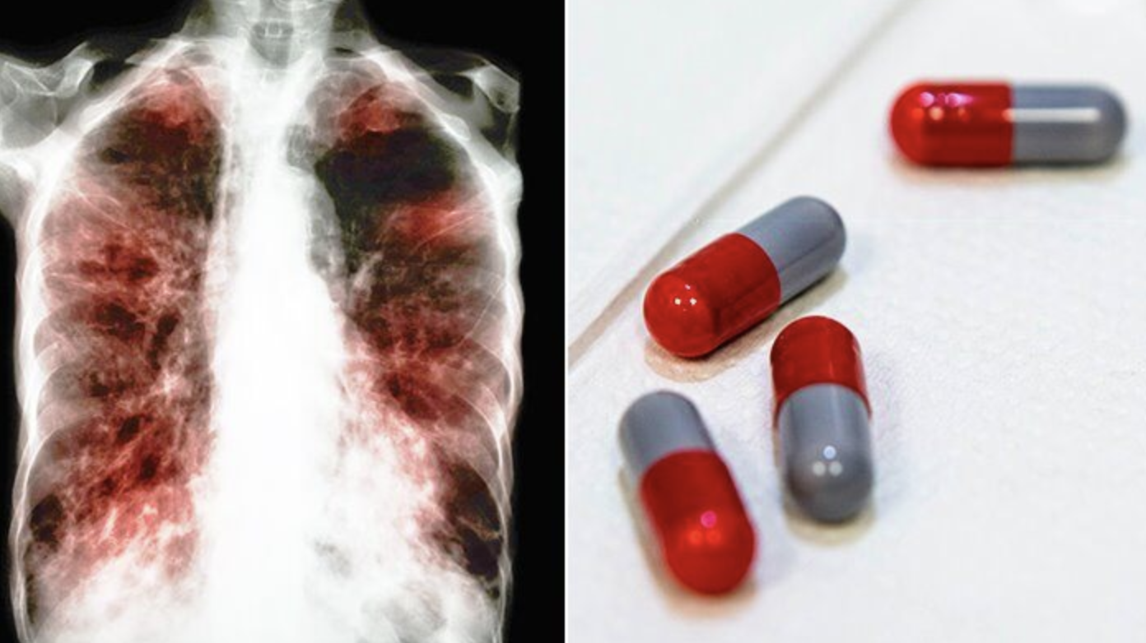
Reduce friction: Increasing adherence to TB medication in Moldova
Notes:
KEY MESSAGES:
In 1952 the scientist that discovered the cure for TB won a Nobel prize. 50 years later it still kills more than a million people because of low adherence to the medication. As a result, WHO recommended that people are observed taking their medication. In Moldova this means people had to travel to a clinic every day and take their pills in front of a TB nurse.
TIMING:
1 min

Slide 36
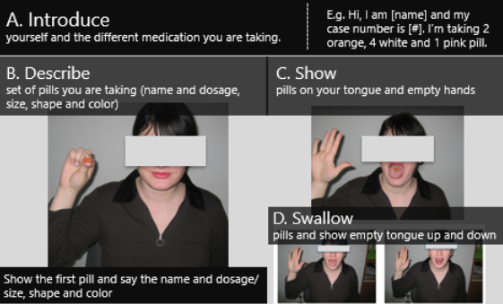
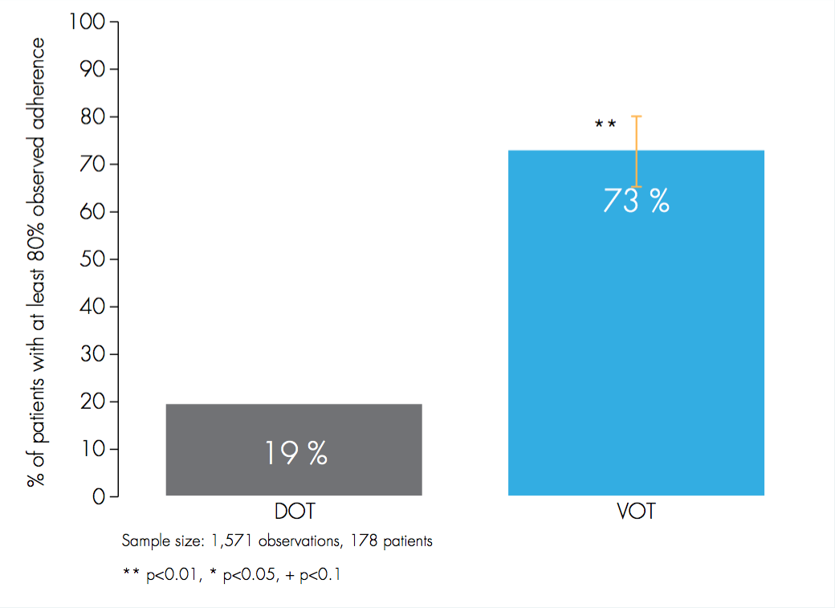
Reduce friction: Increasing adherence to TB medication in Moldova
Ravenscroft, L., Kettle, S., Persian, R., Ruda, S., Severin, L., Doltu, S., ... & Loewenstein, G. (2020). Video-observed therapy and medication adherence for tuberculosis patients: randomised controlled trial in Moldova. European Respiratory Journal, 56(2).
Notes:
KEY MESSAGES:
So, we offered TB patients an easier way to carry out their observed treatment - via video.
TIMING:
30s

Slide 37
EASY
ATTRACTIVE
TIMELY
SOCIAL
Attractive
Notes:
KEY MESSAGES:
“Next we’ll look at making an example attractive...”
TIMING:
30 sec
LINK:
To next slide
TOTAL TIMING FOR ATTRACTIVE
10 mins

Slide 38
Making it attractive
ATTRACTIVE
Attract
attention
Personalise experience
Provide
incentives
Notes:
KEY MESSAGES:
Attract attention
Behavioural scientists use the term ‘salience’ to refer to people’s tendency to pay attention to stimuli that are novel, simple and accessible.
For example, we found people were more likely to respond to the Irish Revenue when a handwritten post-it note was placed on the envelopes.
If you want someone to pay attention you need to design messages in a way that draws attention forwards. Use images, color or personalisation.
People are more likely to respond or read something that feels personally relevant or addressed. By including something as simple as someone’s name in a generic communication, we can increase response rates.
(Traditional incentives you might think of) Incentives - consider financial, non-financial, group incentives.

Slide 39
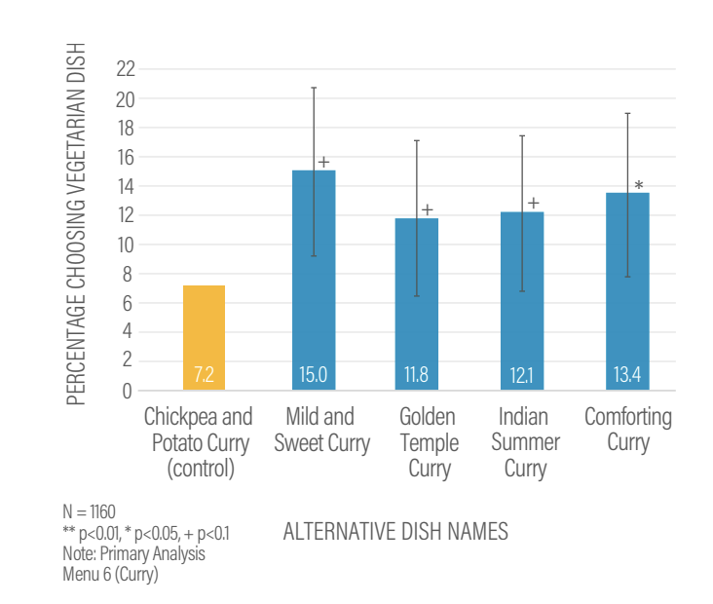
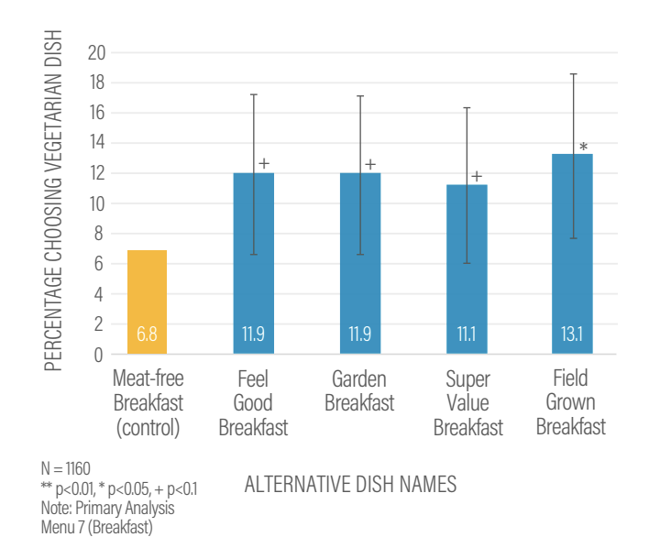
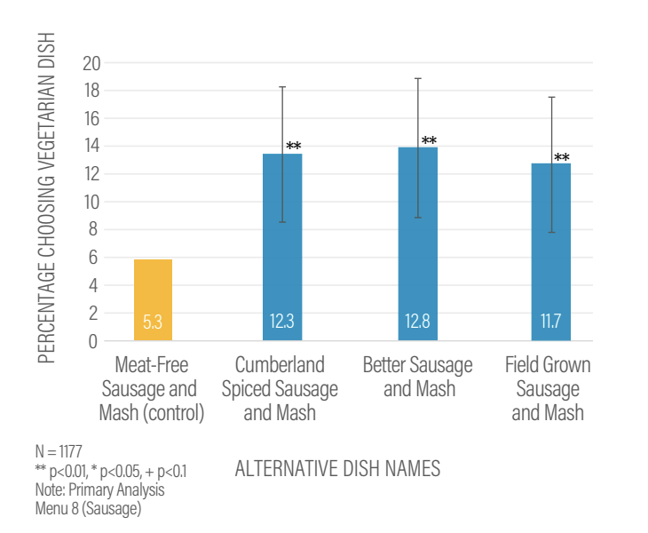
Framing

Slide 40
Encouraging women to attend breast screening appointments

Slide 41
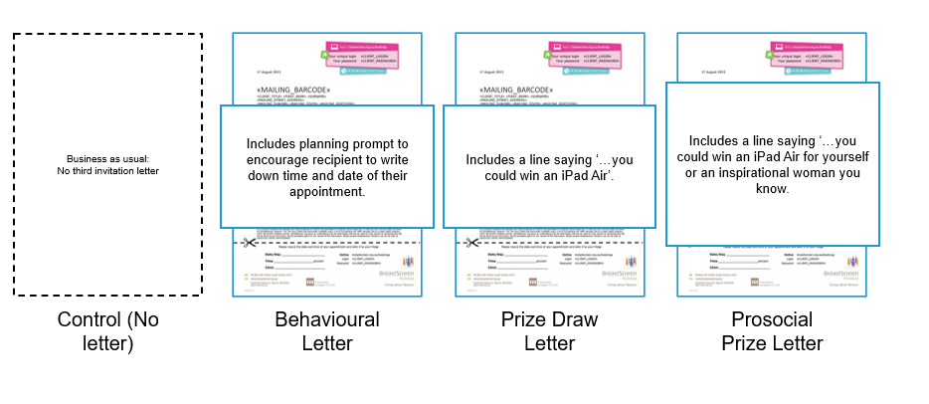
Third invitation sent to non-responses
Notes:
N = 37,761 split across all conditions. People contacted were women who were due for their first breast screen in Victoria in 2013 and 2014, who hadn’t responded to the two previous invitations.
Behavioural – planning prompt, write down the time and date of their breast screening apt
Prize draw – letter entered respondents into a prize draw to win an iPad
Prosocial – receiptents were told they could give the prize to a valued other person

Slide 42
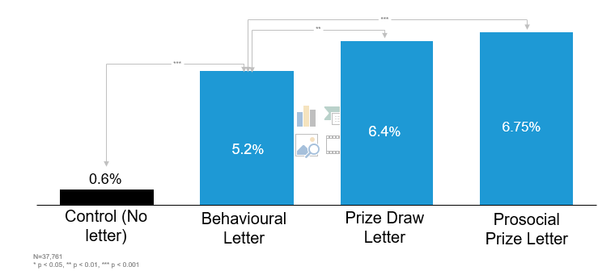
Prize draw increased bookings
Notes:
All of the letters were more effective than control and the prize draw letters were the most effective – although about as effective as each other.
You might be wondering how much offering people an iPad would cost, but actually the prize draw cost approx $1.50 per additional appointment booked – additional to the behavioural letter, making it highly cost-effective
We estimated that if prize letter was rolled out it would result in 4,100 more women booking appts than BAU approach

Slide 43
How would you get people to consume less sugar through fizzy drinks?
Notes:
PURPOSE:
Share real life, non-BIT, example
KEY MESSAGE:
“Thinking attractive, how would you get people to consume less fizzy drinks?”
TIMING:
30 sec
LINK:
To next slide
.

Slide 44
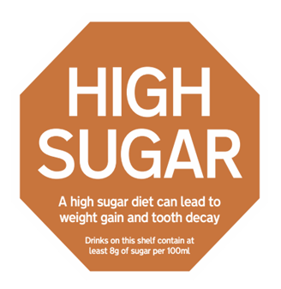
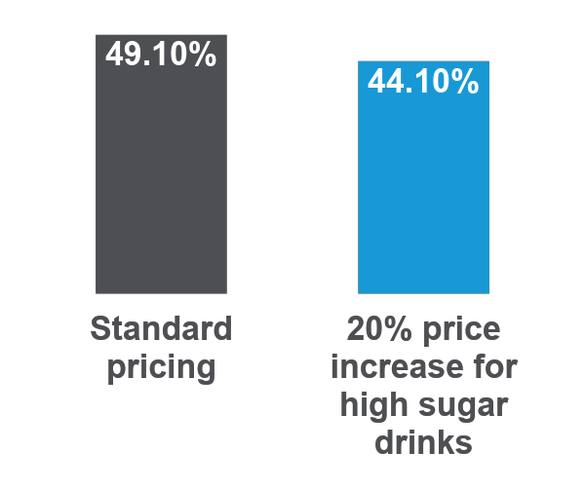
Interventions targeted at the individual
Attract Attention
Refocus Attention
Incentivise
Pop out ‘stop signs’
Positioning out of sight
20% price increase
Relative impact on sales after position change
Proportion of high sugar drinks sold
Low Sugar drinks
No Sugar drinks
+8%
+4%
High Sugar drinks
-12%
This labelling intervention reduced sales of high sugar drinks by 7.3%.
Notes:
PURPOSE:
Illustrate attractive examples at INDIVIDUAL
KEY MESSAGES:
Attract their attention.
Working with the Local Govt Association (LGA) and Liverpool City Council, we tested the addition of simple, pop out ‘stop signs’ on shelves containing high sugar drinks across three hospital stores. This labelling intervention reduced sales of high sugar drinks by 7.3%. Over a year that means 930 fewer high sugar drinks purchased across these three stores.
Re-focus their attention.
Positioning: Working with the Alfred hospital in Australia, we placed high sugar drinks out of clear sight. This led to a 12% relative reduction in sales, which was offset by purchases of low or no sugar alternatives.
Financial Incentives.
Price: Working with the Alfred hospital in Australia we trialled the impact of a 20% sugar tax by changing prices within vending machines. We saw a 10% reduction in the proportion of high sugar drinks being purchased, but no decline in sales.
TIMING:
3-4 min
LINK:
To next slide

Slide 45
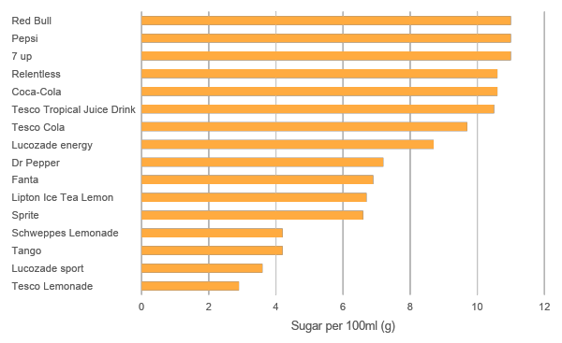
Strategic interventions
Quality Adjusted Life Year (QALY Gain - £3 billion)
Notes:
PURPOSE:
Illustrate attractive examples at MANUFACTURER
KEY MESSAGES:
“By redesigning the food environment, 50% of manufacturers reformulated their drinks, taking 45 million kg of sugar out of drinks every year!
This is estimated to give a quality-adjusted life year (QALY) gain of over £3 billion.
The quality-adjusted life year (QALY) is a generic measure of disease burden, including both the quality and the quantity of life lived. It is used in economic evaluation to assess the value of medical interventions. One QALY equates to one year in perfect health.
TIMING:
2 min

Slide 46
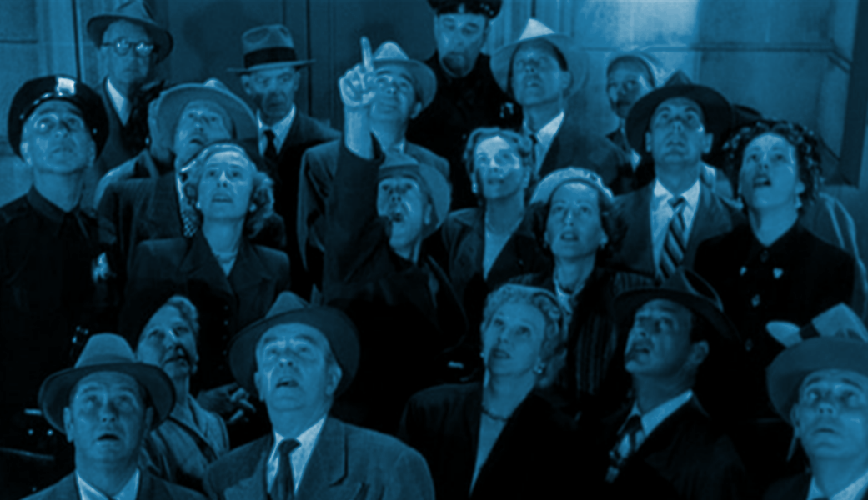
EASY
ATTRACTIVE
TIMELY
Social
SOCIAL
Notes:
KEY MESSAGES:
“Next we’ll look at making an example social...”
TIMING:
30 sec

Slide 47
Making it social
SOCIAL
Highlight helpful social norms
Leverage networks
Use reciprocity effects
Notes:
The key message here is that we tend to behave the way we think most other people do.
For instance, telling 3000 doctors in London that ‘the great majority of practices in London prescribe fewer antibiotics per head than yours’ resulted in a saving of 70000 doses of antibiotics, saving £92,356 in public sector prescription costs.
Leverage networks
People’s friends and peers can help them change their behaviour. - the above example uses that idea of peers, but perhaps more directly you can think of quite intuitive examples where if we say made a commitment to our friends and family that we would stop smoking, that’s probably going act as a good incentive to stick to that commitment
Use reciprocity effects
we tend to help people who have helped us -

Slide 48
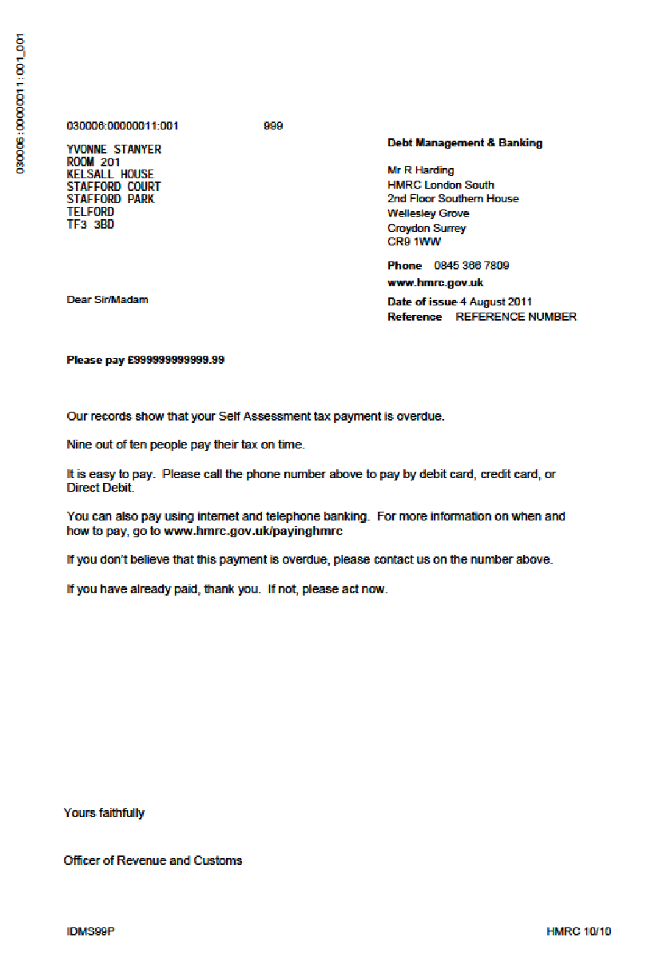
Increasing tax payments
With HMRC, our tax trials brought forward £200 million in 12 months.
Nine out of ten people pay their tax on time
Notes:
PURPOSE:
Illustrate social norm
KEY MESSAGE:
“We brought forward £200 million for the tax agency in the UK.
BIT tested different types of messages describing how others behave to encourage people to pay their outstanding tax debts.
The best letter brought-forward an extra $14 million in 23 days.
Building on this example, additional projects have increased tax-collection in Guatemala, Costa Rica, and Poland.
This work has collectively brought in well over £1 billion making it another one of our BI Unicorns.”
TIMING:
1-2 min

Slide 49
Social norm mechanisms - a word of warning
Telling people 9 out of ten people pay their tax on time increased those paying within 23 days (BIT)
1. Simple norm (emphasise positive behaviour) - others have done a desirable behaviour so I should too
2. Negative framing example (emphasise negative behaviour) - others have not done it, so I should instead
3. Free rider backfire (emphasising positive behaviours) - many people have done it so I don't need to
4. Boomerang effects backfire (emphasise negative behaviour) - many people have done an undesirable behaviour, it’s more common than I realised - or I didn't realise I was better than the average
Framing the number of Wikipedia donors in a negative way (i.e. not many people donate) increased donation rates (Linek & Traxler, 2021)
In Mozambique, highlighting the high support for social distancing reduced self reported social distancing in areas with low Covid cases (Allen et al, 2021)
Households with relatively low energy use increased their energy consumption after receiving descriptive information about their neighbors’ average energy use (Schultz et al, 2007)
Emphasising the wrong norm can encourage the very behaviour we want to avoid
Notes:
Skip if you are presenting 60 minutes only. Ask people to raise hands in session instead.
PURPOSE:
Show backfire effect
KEY MESSAGE:
“But be careful with social norms...they aren’t always a golden ticket.
TIMING:
1-2 min

Slide 50
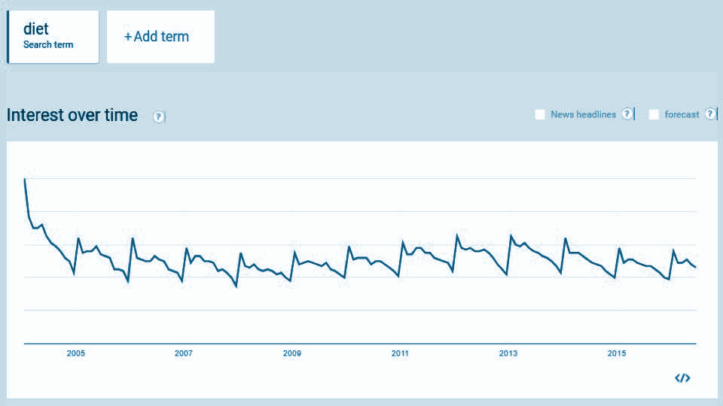
EASY
ATTRACTIVE
TIMELY
Timely
SOCIAL
Notes:
PURPOSE
Introduce Timely and policy examples to follow
KEY MESSAGES:
“Finally, we’ll look at specific timely examples, to build on the NHS text which touched on this theme....”
TIMING:
30 sec
TOTAL TIMING FOR TIMELY
7.5 mins

Slide 51
Making it timely
TIMELY
Consider the immediate costs and benefits
Help people plan their responses to events
Prompt people when they are most likely to be receptive
Notes:
We are more influenced by the costs and benefits that take effect immediately than those delivered later. This is because the present moment is much more tangible than the distant future.
Example along these lines in one of the homework exercises on cognitive biases - where someone put that they value eating a cake immediately more than going to the gym, even though the latter would be more beneficial to them in the long term
In terms of policy-making we should be paying attention to this and think about whether or not there can be an immediate benefit placed up front, even if it is small to make the desired behaviour more present focused. - prize linking
Planning
Helping people to plan their actions can help reduce this idea of distance. Prompting people to identify the barriers to action and developing a specific action plan to overcome.
We are going to go on to talk about how this idea has been applied in the context of getting people back into work.
Prompts
Prompt people when they are most likely to be receptive. The same offer at different times can have drastically different levels of success.
e.g. people are more likely to leave a legacy gift in their wills at the moment they are writing their wills.

Slide 52
Using timely prompts to reduce patient waiting times

Slide 53
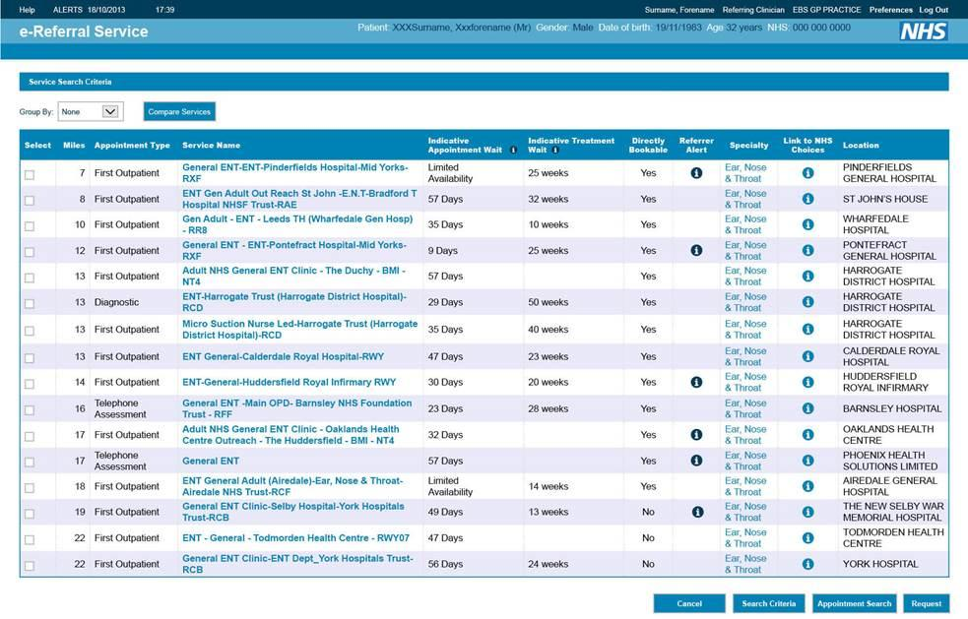
The original interface for patient referrals

Slide 54
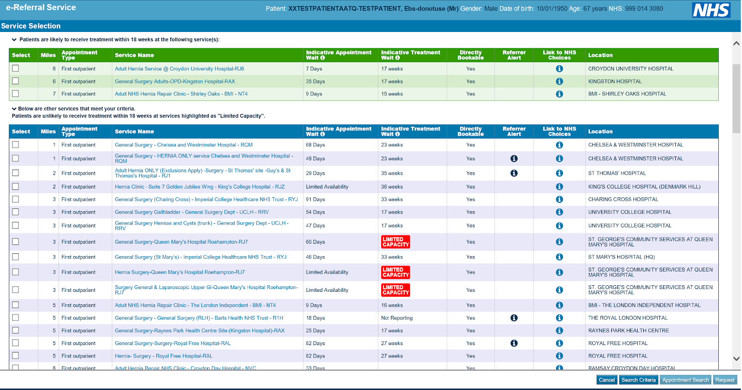
New system of red alerts and green highlights
Notes:
We worked with NHS England and NHS Digital to redesign the nationwide patient referral system interface.
We made two changes to make wait-times salient – at the time a referral is being made.
•We added a red ‘Limited Capacity’ flag to clinics where waiting times were very long.
•And a green box, at the top of the screen, listing three local options with good capacity.

Slide 55
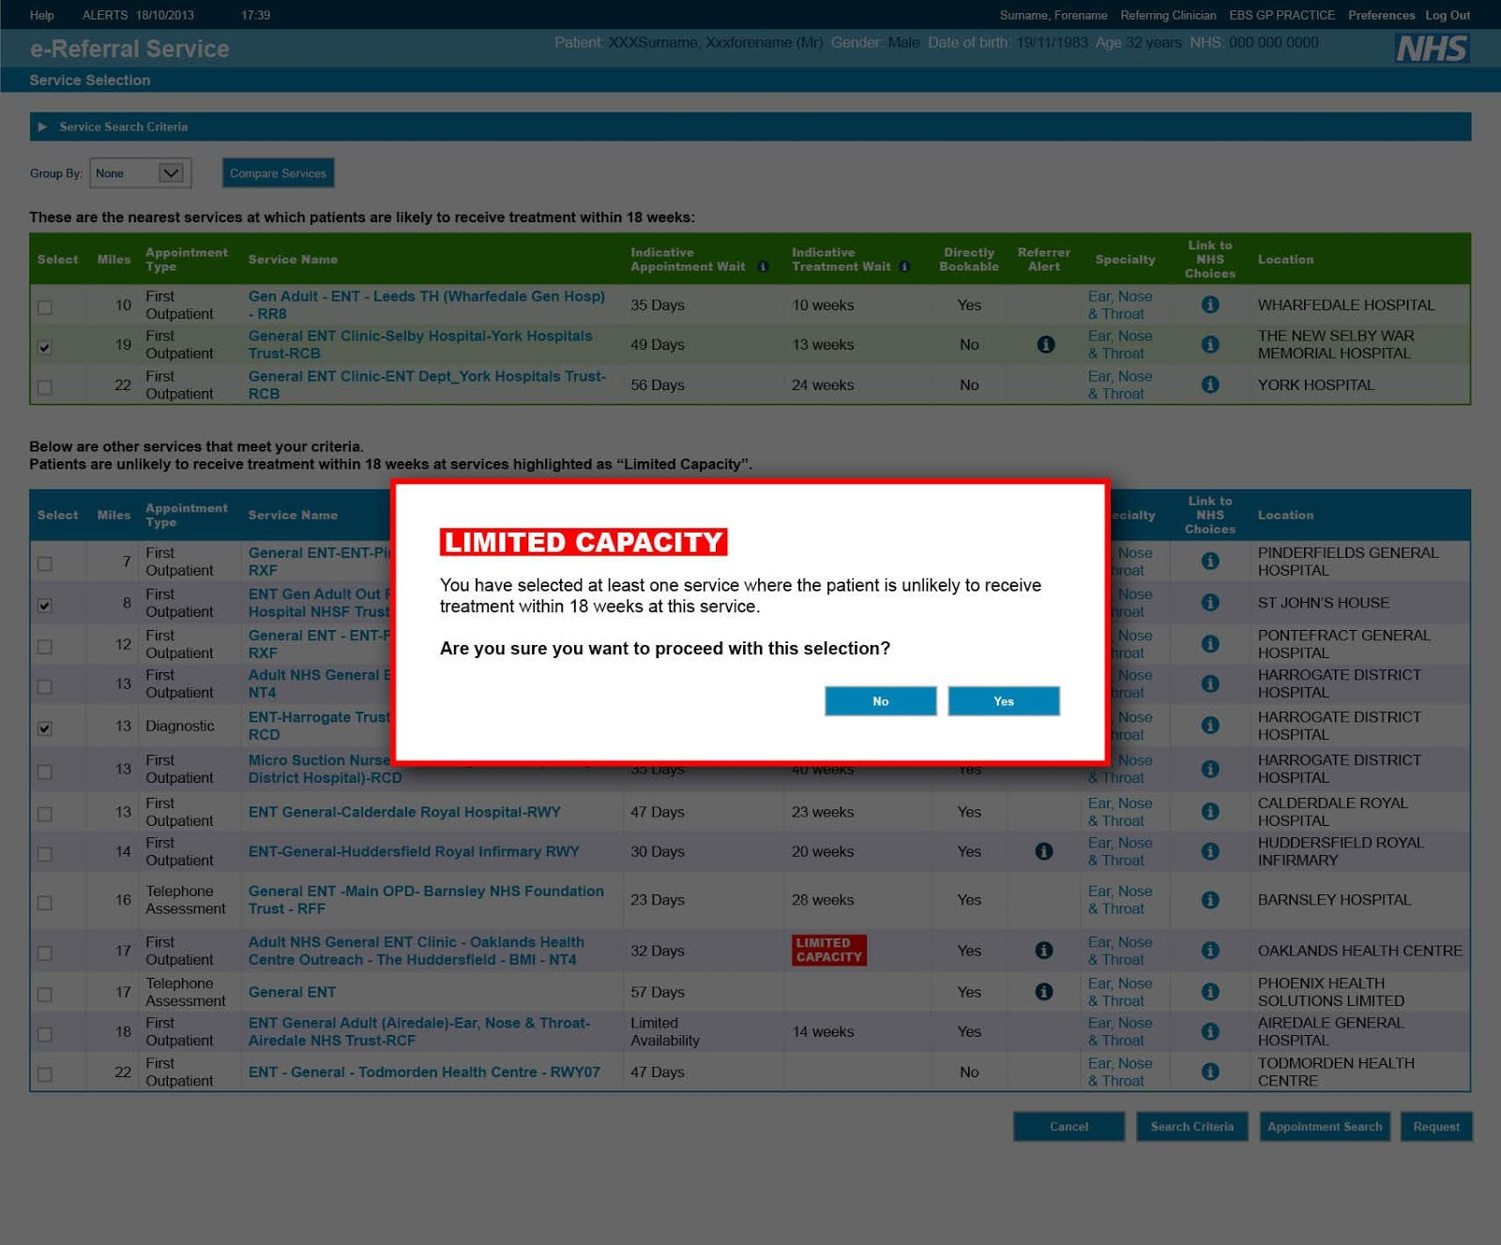
Pop-ups to increase friction costs
Notes:
If doctors shortlisted one of these limited capacity services, a pop-up box appeared that prompted them to discuss long waiting times at these services with their patients.

Slide 56
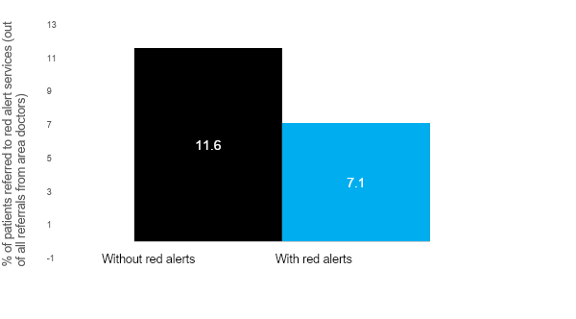
Red alerts shown to be effective
Red alerts reduced referrals by 38%
**
* p<0.05, ** p<0.01, *** p<0.001. n=5,563
Notes:
In East London, the changes resulted in a 38 per cent reduction in referrals to clinics with long waiting times.

Slide 57
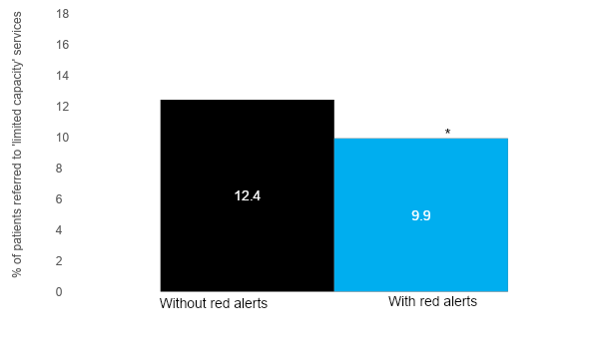
Results for red alerts replicated with a 8.8k sample
Red alerts reduced referrals by 20%
*** p<0.001, **p<0.01, *p<0.05, +p<0.1 n = 8,838
Notes:
Rolling out the alert system to another area of London confirmed the effect of the red limited capacity alerts. This time, the alerts led to a 20% reduction in referrals, but also resulted in a 14% increase in referrals to services with green alerts.
NHS England is now rolling out the alerts system nationally as a tool for regional teams to quickly address capacity problems in their local health systems.

Slide 58
Solution
Build your intervention
Notes:
(2.05 pm)
Back to your policy problem - next step is coming up with intervention ideas

Slide 59
Analyse the types of intervention available
Notes:
PURPOSE:
The next step in the methodology is the identify who contributes to this goal and what specific behaviours contribute to the success or failure of the goal - what behaviours produce the outcome we want to see
Line up audience for next few slides which go through why we focus on behaviours
KEY MESSAGE:
Now that we have the high level goal we’re going to work on we need to identify who contributes to this goal and what specific behaviours contribute to the success or failure of the goal.
TIMING:
30 seconds
LINK:
To next slide

Slide 60
What types of intervention are available to you?
Some key interventions where a behavioural insights approach can be applied.
Information Provision
Environment Design
Process Design
Incentives
Systemic Rules
Can you change the information provided to tell people how to perform a behaviour or why they should perform a behaviour?
Can you redesign the environment in which decisions are made or space in which activities are completed?
Can you redesign the process people have to follow to perform a behaviour?
Can you change the costs or benefits that incentivise or motivate a behaviour?
Can you change the fundamental rules that govern the behaviour, such as regulations, laws, or policies?
© The Behavioural Insights Team
Notes:
PURPOSE:
Explain the different interventions where you can apply a BI approach
KEY MESSAGE:
These interventions are not exhaustive but a useful starting point.
TIMING:
2 min
LINK:
To next slide

Slide 61
How can behavioural insights enhance these interventions?
Some examples of how a behavioural insights approach can be applied to these interventions.
Information Provision
Environment Design
Process Design
Incentives
Systemic Rules
Framing
Social norms
Influential messengers
Salience
Choice Architecture
Habit Forming Environments
Removing Friction
Simplifying
Peak-End-Effect
Primacy / Recency Effect
Non-financial rewards
Group Incentives
Timing of Incentives
Public signals of success
Progression charts
Defaults
Regulation
Legislation
© The Behavioural Insights Team
Notes:
PURPOSE:
Explain examples of how BI can improve the effectiveness of these interventions
KEY MESSAGE:
Information Provision
Framing - many tax authorities around the world have run experiments have shown that changing the presentation of forms or reminder letters can substantially increase tax compliance. These changes might involve introducing new information, such as stating that the recipient is in the minority of people who have not paid; or they can focus on making existing information clearer, like clarifying exactly what someone is required to do in a particular situation
Messenger affect - A series of studies in the US compared the effect of a motivational message from a beneficiary of a worker’s efforts to the same message from their team leader. These studies consistently find that, when emphasizing the positive impact of a task, beneficiaries are significantly more effective than leaders when it comes to improving productivity and performance
Incentives
Non financial incentives - In Zambia researchers recruited hairdressers (influential messengers) to sell female condoms. Tested monetary and non-monetary rewards - 90% commission, 10% commission and non financial incentive (public signals of success and progression charts). While the financial incentives were no more effective overall than the control, over the course of a year the sellers with the star chart sold around double the number of condoms. The results of this experiment show that applying behavioral insights to incentives, such as incorporating public signals of success and outcome-oriented progression charts, can increase motivation in low-resource environments, even out-performing traditional financial incentives.
Group incentives - giving financial rewards for group outcomes resulted in greater healthy weight loss compared with rewarding individual performance: the added motivation to not let down a teammate supercharged the promise of financial gain
Environment
Employees in a Chinese textile factory were in the habit of throwing waste scraps of cloth on the floor next to them, creating a slipping hazard. Workers were financially motivated to continue working without breaks. Researchers partnering with the factory thought that meaningful visual cues on the floor might help change behavior. They introduced decals depicting golden coins on the production floors. Culturally, golden coins are considered an omen for fortune and luck, meaning the employees would have a disincentive to cover them. Following a five month period of experimentation, waste on the floor had reduced by over 20%. A small, contextually meaningful, tweak to the design of the environment was enough to overcome a seemingly entrenched habit.
Process
Peak-end-effect - In the medical domain there is a received wisdom that it’s “better to get it over with”. This ethos, coupled with efficiency considerations for hospital services, mean that speed is often implicitly valued in medical procedures, especially where pain is involved. In Toronto, 1995, a team of physicians and academics were grappling with a very specific research problem: decreasing pain perception among colonoscopy patients. Their research hinged on a phenomenon known as the “peak-end rule”. This rule states that our judgment and memory is disproportionately shaped by the peak moment and the very last part of an experience. Since colonoscopies at the time typically conformed to the notion of “better to get it over with”, they inevitably induced significant discomfort in the final moments. A slower “exit”, the team hypothesized, would be perceived as less unpleasant, even though it would make for a longer procedure. The insight proved correct: patients whose colonoscopies involved an additional three minutes of slow extraction rated their overall pain to be lower and had a more favorable view of the experience.
Rules
Defaults- Switching to a greener household energy tariff is one way that most of us could reduce our carbon emissions. Traditional approaches to increasing switching usually involve giving us more information to influence our decision. In Germany, in the late 1990s, an energy company in the south broadened its service to include three tariffs: the cheapest, the least environmentally friendly one; a mid-priced but greener tariff; and a more expensive, and even more eco-friendly, tariff. Since customers had to be on one of the three tariffs, the starting point - the pre-selected default - was the middle option; customers could switch to go greener or cheaper if they wanted. After 2 months, 94% of customers stuck with the default tariff, with the effect of automatically flipping most of a market to a greener alternative overnight. Just 4.3% went with the cheaper option, 1% chose the greenest but more expensive tariff, and 0.7% of customers switched to another supplier.
It is not just consumers who are influenced by defaults: 80% of countries accept treaty adjudication by the International Court of Justice when it is the default option, compared with only 5% when the country has to actively choose it.
TIMING:
2 min
LINK:
To next slide
REFERENCES
Ashraf, N., Bandiera, O. and Jack, B.K., 2014. No margin, no mission? A field experiment on incentives for public service delivery. Journal of Public Economics, 120, pp.1-17.
Grant, Adam M., and David A. Hofmann. "Outsourcing inspiration: The performance effects of ideological messages from leaders and beneficiaries." Organizational Behavior and Human Decision Processes 116, no. 2 (2011): 173-187.
Wu, Sherry Jueyu, and Elizabeth Levy Paluck. "Designing nudges for the context: Golden coin decals nudge workplace behavior in China." Organizational Behavior and Human Decision Processes (2018).
Redelmeier, Donald A., Joel Katz, and Daniel Kahneman. "Memories of colonoscopy: a randomized trial." Pain 104, no. 1-2 (2003): 187-194.
Pichert, Daniel, and Konstantinos V. Katsikopoulos. "Green defaults: Information presentation and pro-environmental behaviour." Journal of Environmental Psychology 28, no. 1 (2008): 63-73.

Slide 62
Intervention considerations
Consider which intervention will be most effective for the behaviours you want to change.
Information Provision
Environment Design
Process Design
Incentives
Systemic Rules
Are information campaigns having the desired effect?
Who does the end user listen to?
What channels are available?
Is the environment conducive to the behaviour?
What barriers in the environment are preventing the target behaviour?
Are existing processes having the desired results?
Is there friction in the process?
Are the incentives aligned?
Can the behaviour be changed without enforcing rules?
© The Behavioural Insights Team
Notes:
PURPOSE:
Explain the factors to consider when assessing which intervention to use.
KEY MESSAGE:
For each intervention there are a number of factors to consider.
Real examples
TIMING:
2 min

Slide 63
Apply behavioural insights to generate solutions
Notes:
PURPOSE:
The next step in the methodology is the identify who contributes to this goal and what specific behaviours contribute to the success or failure of the goal - what behaviours produce the outcome we want to see
Line up audience for next few slides which go through why we focus on behaviours
KEY MESSAGE:
Now that we have the high level goal we’re going to work on we need to identify who contributes to this goal and what specific behaviours contribute to the success or failure of the goal.
TIMING:
30 seconds
LINK:
To next slide

Slide 64
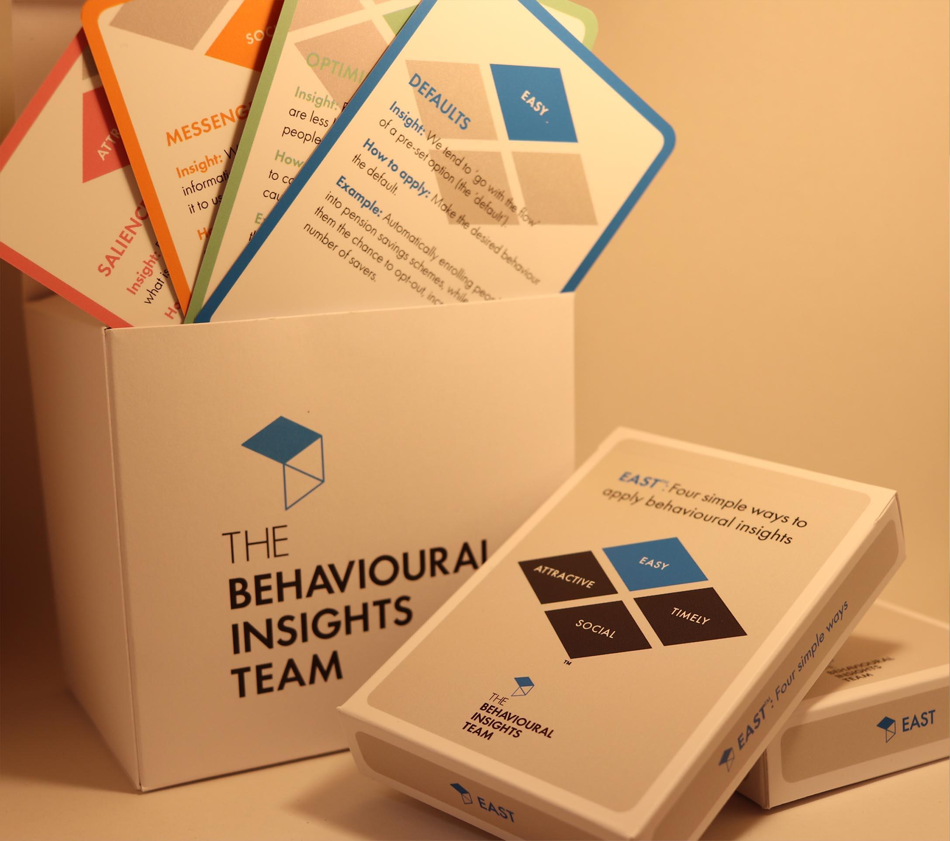
EAST Cards to generate solutions
EAST Cards: A set of practical cards that explain core principles from behavioural science and how to apply these principles to policy challenges.
These cards enable new practitioners to quickly understand and apply behavioural insights.
Each card outlines;
1 behavioural insight
Guidelines for how to apply this insight to solve a challenge
An example
Notes:
PURPOSE:
Introduce EAST cards and game.
KEY MESSAGES:
You’re now going to use our EAST cards to generate behavioural solutions.
Our EAST cards have been designed based on our EAST framework to support practitioners to come up with new ways to apply behavioural insights.Each card outlines one behavioural insight, guidelines for how to apply this insight to solve a behavioural challenge and a worked example.
These EAST cards are based on our EAST framework and contain 39 behavioural insights condensed into 1 neat card pack that can be used to help support new practitioners in generating behavioural insights solutions. Each card falls under one of the 4 EAST components.
In a few moments you will use these cards to design behavioural interventions. We have created a digital tool for you to use online
But first, I want to go through a few things to structure this exercise”
HOW TO DO IT:
You’ll hand out packs of cards. Demonstrate the game (5 min) and then give the audience time to play (45 min).
TIMING:
1 min

Slide 65
Trial phase
TARGET
EXPLORE
SOLUTION
TRIAL
SCALE
Phases
Develop a strategy to assess if the results you observe are due to your intervention or not and evaluate the effectiveness of your intervention.
Notes:
PURPOSE: Set up Trial - sometimes interventions do nothing, sometimes they backfire… more policies are still not evaluated.
KEY MESSAGE:
In the trial phase of our projects, we test whether our solutions were effective in changing the target behavior and to what extent they were effective in doing so.
Evaluation is a key part of BIT - rigorous evaluation. A core mission of ours has been to introduce rigourous evaluation into policymaking.
Often, if it’s appropriate we will run a randomised controlled trial (RCT).
Crucial to test interventions because, as we’ve previously established, context is key. We need to properly test and evaluate interventions because sometimes they do nothing and sometimes they backfire.
In the trial, we need to define the outcome measure
Then develop a strategy to analyse the results to see if the intervention changed any behaviours.
TIMING:
1-2 mins
LINK:
To next slide

Slide 66
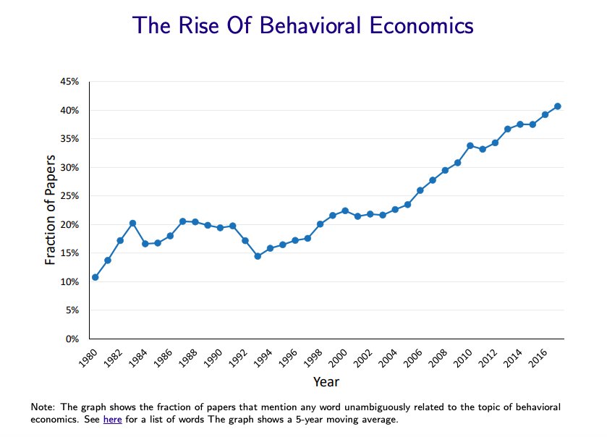
Another internal note: why all the fuss about evaluation at BIT (and elsewhere)?
Source: Kleven (2018)
Notes:
No one really knows (key point to come back to)

Slide 67
Evaluation can mean many different things: the ‘Trial’ phase usually covers impact evaluations
Process Questions
Impact Questions
Ask “What’s going on?”
Tell you what’s happening and how
Focused on understanding a program’s outputs
Ask “What are we achieving” or “Which is better?”
Tell you the effect of something
Focused on understanding a program’s outcomes or impact
Process evaluation
Impact evaluation
Notes:
Differentiate between process and impact evaluations
BIT does both but our focus is usually impact evaluations
When is each appropriate
Ask for examples from participants of process / impact evaluations they’ve been involved in

Slide 68
The importance of trialling
We’re already pretty sure we know the answer
Results can be surprising, and even if we’re right about the direction, what is the effect size?
Are participants are telling the truth? Do they really know what they want, and how their behaviour will change in a new situation?
We can run interviews, surveys and focus groups to find out what will work best
We will apply the intervention and measure before and after to determine the effect
How do we know other factors didn’t play a part? What if an improvement would have happened anyway?
Compare different individuals, groups or areas
How do we know that the groups aren’t also different in other important ways?
Notes:
PURPOSE
Introduce reasons for running Randomised Controlled Trials
KEY MESSAGES:
As we discussed on Day 1, we run experimental trials for many reasons.
We run trials to know whether and to what extent an intervention has worked. This is important, as results can be surprising - even if you think you have a great idea, it might have no impact at all, or even a negative one
Qualitative research such as interviews, surveys and focus groups are great - and a core of what we do - but they do not give you an objective measure of impact, and people’s words may not be in line with their actions
We’ve seen that before and after trials do not give you a reliable measure of impact, as other external factors can affect the results
And if we compare results across groups two different groups. But if those groups differ in their make-up, the change in behaviour could just be due to those differences and not your intervention itself.
TIMING:
1 min

Slide 69
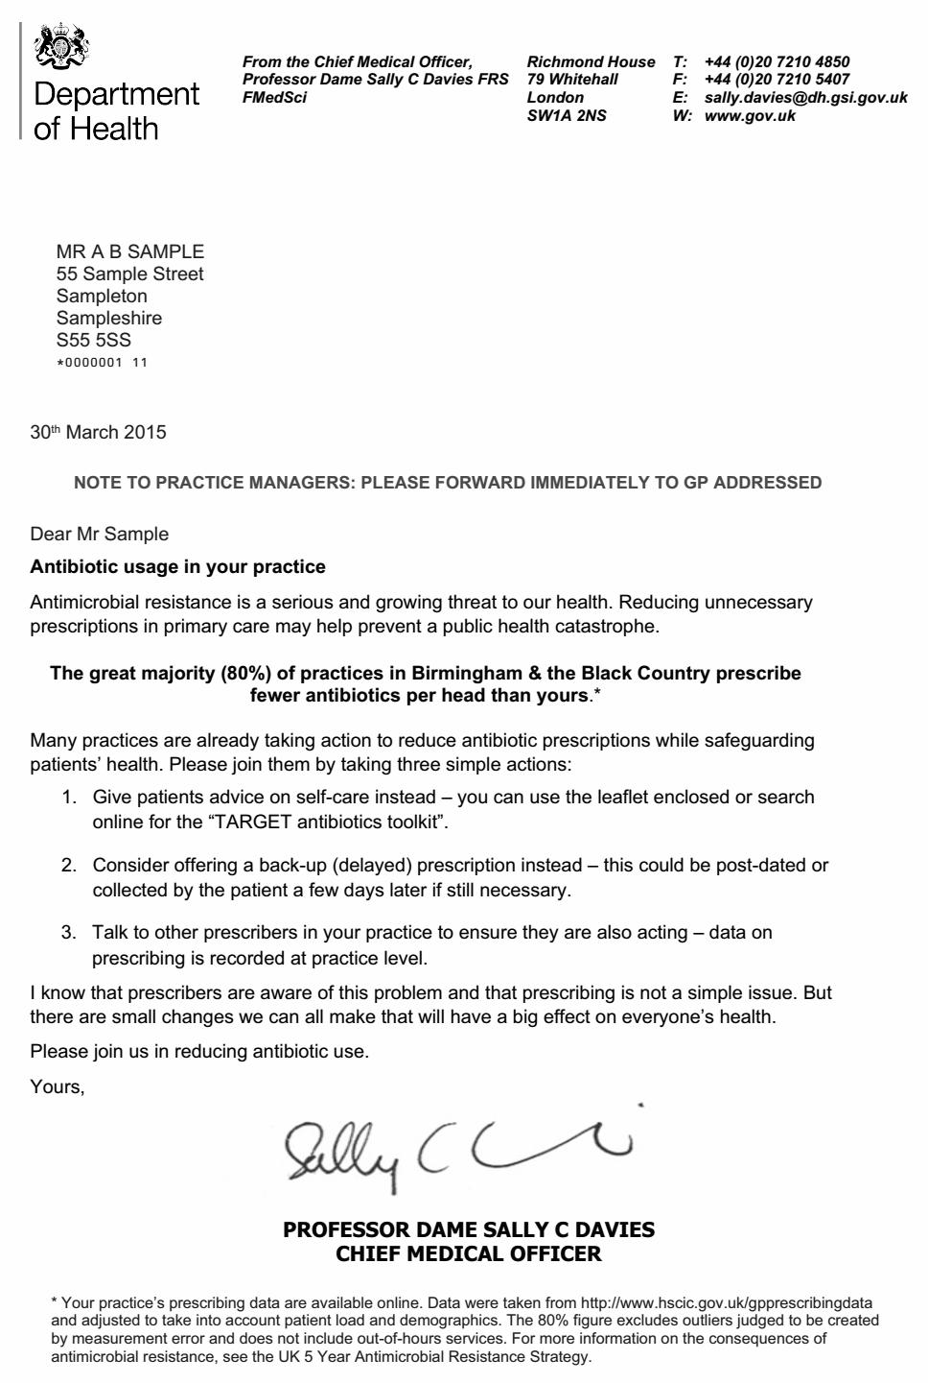
Recap of RCTs
INTERVENTION
Rate of antibiotic prescriptions is measured in both groups and compared
CONTROL
Notes:
PURPOSE
Recap RCT - with AMR examples
KEY MESSAGE:
So we rely on Randomised Controlled Trials as a way of overcoming these differences.
In these trials, we create a control group, who don’t receive the intervention, and a treatment group who do.
We ensure that the two groups have similar characteristics, so that a difference in results can be caused only by the intervention.
We do this by ensuring our sample is large enough, and by randomising who joins which group. If the sample is large enough, our two groups should be similar.
TIMING:
1 min

Slide 70
Why trials? They may be unethical!
It can be more unethical to go ahead without knowing what works.
Resources are limited. Knowing what works best can be as important as knowing whether something works at all.
There are various trial designs (RCTs, stepped-wedge trials, lab testing/prototyping), some of which are less controversial than others
Notes:
PURPOSE
Introduce ethical criticisms of trials
KEY MESSAGES:
Before going into the fundamentals of running an evaluation, it’s important to flag that trials evoke certain ethical considerations.
Even if one accepts the logic of running a trial, important ethical points have to be considered before you start. I will go into these in more detail tomorrow.
But just to give you a flavour, a point that is often raised is that it may not be ethical to run a trial.
If you imagine the example of an intervention in school which might improve the results of a group of a students, it can be argued that a trial may unfairly disadvantage some pupils.
As we have seen, interventions can sometimes have pretty disastrous backfire effects.
Unless we have high levels of confidence that something will work, it makes sense to test this rigorously.
Moreover, resources are limited. Trials can help us identify which solutions work best so that we can prioritise those resources effectively, ultimately benefiting all of the target population.
And there are ways to ensure that all participants in a trial receive the intervention. So in schools example, we can design the trial in a way that all pupils receive the intervention, but at different times.
TIMING:
1 min

Slide 71
Key steps of an RCT
Plan the intervention
2. Determine the outcome
3. Decide unit of randomisation
(eg individuals, institutions or geographical areas)
4. Power Calculations
(How many units – people, institutions, or areas - are required for a robust result?)
5. Random assignment
6. Implement intervention
Notes:
PURPOSE
Introduce importance of planning
KEY MESSAGES:
Now going to talk through 6 key steps of running a trial
The first is to identify and plan the intervention.
Identifying what is likely to be an effective evaluation is important - and we’ve talked about how this can be achieved during the explore phase
But its implementation is crucial. If you are running a trial with another ministry or agency, it is often they who will manage the day-to-day running of an intervention and not you, so its functioning needs to be absolutely crystal clear
TIMING:
1 min

Slide 72
If you remember nothing else...with RCTs...
Planning is everything
Simplicity is key
Notes:
PURPOSE:Headline - plan and keep it simple
KEY MESSAGE:
So if you are to take nothing else away from this module, take away this: that planning is everything and simplicity is key.
When we run a trial, we pre-specify, plan, design as much as we can in advance to reduce errors, ensure we keep ourselves to what we originally set out to do.
My two main takeaway points - if you remember nothing else - is to start simply and think through the practicalities of your trial as much as you can.
TIMING:
30 secs

Slide 73
Think through the practicalities
“It would be awesome if parents were texted ahead of a Math test.”
“Great idea!”
“Wait… Who will do it? How will we get the dates?... And when will we text them?”
Notes:
PURPOSE
Headline - plan and keep it simple
KEY MESSAGE:
To illustrate this point, imagine you decided to run an intervention in schools, whereby text messages were sent to parents before their children sat tests at school - the idea being that children would talk with their parents about the test and help them to study.
Sounds simple enough, but if you want it to work, you need to consider who will send the texts, when they’ll be sent, what they’ll say and how you’ll get the test dates, among other things.
When you get into the nitty gritty, it could be more complicated than it might initially seem.
TIMING:
1 min

Slide 74
Agree who does what and when
Who will text them?
When will you text them?
How will you get the dates?
“It would be awesome if parents were texted ahead of a Maths test.”
Heads of Depts fill in test details
Teachers/Heads of Dept inform Researcher of changes
Teachers text back if test date changed
2
4
6
School
Researcher sends link to online form for providing test details
Researcher schedules texts
Text teachers notification that texts start
(1 week in advance of test)
Text sent to parents 4 days and 1 day in advance of test
Researcher
1
3
5
7
Parents encourage child to study
Parent
8
Notes:
PURPOSE:
Agree who does what and when...
KEY MESSAGE:
So it is vital to agree who does what and when.
This is the less glamorous side of running trials, but it’s really important. Your delivery partners may be reluctant to take part; they need to be convinced that the process is straightforward and makes sense.
“We use swimlanes to better map out what happens to each group and what they need to do and when.
This clarifies what the team need to do, to make this happen.
TIMING:
1 min
LINK TO:
Next slide

Slide 75
Interventions can become complex
Notes:
PURPOSE: Agree who does what and when...
KEY MESSAGE: And as programmes become more complex, so do their delivery.
This is an example from a large programme of work we did in a number of colleges in the UK, involving multiple stakeholders and several thousand students.
As you can imagine, it’s really useful to map everything out to make delivery as simple as it can be. Planning is very important.
TIMING:
30 secs
LINK TO:
Next slide

Slide 76
Key steps of an RCT
Plan the intervention
2. Determine the outcome
3. Decide unit of randomisation
(eg individuals, institutions or geographical areas)
4. Power Calculations
(How many units – people, institutions, or areas - are required for a robust result?)
5. Random assignment
6. Implement intervention
Notes:
PURPOSE:
Identify your outcome measure
KEY MESSAGE:
So you’ve identified what your intervention will be, and planned how it will work.
Now you need to be clear on what it is you’re trying to change, and how you’re going to measure it.
The key question here is what is your outcome measure – what is the thing you’re trying to change and measure.
Take the example of a trial where you’re trying to encourage people to do more physical activity.
How will you measure behaviour?
Will you track steps per day of people involved in the trial
Or the amount of minutes that they move during a day?
Or could you go for some proxy measure, like footfall in local sports facilities?
And how long are you going to be collecting data for?
These are the key questions that need to be answered during this phase.
TIMING:
1 min

Slide 77
For your solution, think about...
What is your primary outcome measure? What is the main thing you’re trying to achieve?
What other things are you interested in measuring (secondary outcome measures)?
What can you measure during the intervention to ensure the process itself is working (process evaluation)?
Notes:
PURPOSE: Be clear on what you’re trying to measure
KEY MESSAGE:
State up front what your primary outcome measure is. You should only have one primary outcome measure, and it should be the thing you are really trying to achieve. You should be thinking about your primary outcome measure from an early stage and you should define it clearly before rolling out the intervention. This ensures you concentrate your efforts and protects the integrity of the intervention. Try establish a quantifiable objective and identify expected direction and magnitude. Think now about how big an effect we’ll need for a project to be worthwhile. E.g. number of steps per day
Secondary outcome measures - other things you want to measure but that are of lesser importance. Be choosy about what these are (don’t want to have so many that you inevitably find a positive result). E.g. time spent exercising per day, intensity of exercise, average number of steps a day over a week.
Process evaluation - any checks you can build in to ensure programme is working?
TIMING:
1 min

Slide 78
Understand your data
What data do we need?
What data do we have?
Where is the data and what does it look like?
Where does the data go?
Notes:
PURPOSE:
Inspect your data
KEY MESSAGE:
And key to determining this is knowing what data is out there, and how you can collect it.
Key question: can we use data that already exists, or do we have to generate new data among trial participants.
Get into the nuts and bolts of how the data is generated, and how it ends up with you
Who’s providing you with the data?
When do they need to send it?
Have you seen the data before? Do you know the quality?
Are there logical errors?
Missing values?
🡪 it’s a good idea to see what it looks like before you launch, so you know what challenges may exist
Again, planning is everything - “Ask questions about the data. Get a cut of the data early. Understand what you are getting into. Go to where the data is and see it for yourself. Understand what a person needs to do to get information.
Warning if you show results to early - can look like intervention is effective, but at the end it might not be. Risk that intervention could be launched.”
EXAMPLE - on the next slide
TIMING:
1 min

Slide 79
Key steps of an RCT
Plan the intervention
2. Determine the outcome
3. Decide unit of randomisation
(eg individuals, institutions or geographical areas)
4. Power Calculations
(How many units – people, institutions, or areas - are required for a robust result?)
5. Random assignment
6. Implement intervention
Notes:
PURPOSE:
Identify unit of randomisation
KEY MESSAGE:
Another key aspect of designing an intervention is to decide on what’s called the unit of randomisation.
You’re now familiar with individual-level randomisation, but sometimes it isn’t feasible have individuals be the unit of randomisation.
If we take the example of sending text messages to parents - it’s hard to imagine sending text messages the parents of half the pupils of one school, and not the other half. Kids and parents talk a lot, and so it would be very likely that the parents who were not receiving the texts would hear about the intervention, and demand to receive the texts.
In this case, you need a different unit of randomisation. For example, it could be that text messages are sent to the parents in one set of schools, but not in the another.
But what does this mean for trialling?
TIMING:
1 min

Slide 80
Randomisation
Treatment Group
Control Group
Notes:
PURPOSE:
Identify unit of randomisation
KEY MESSAGE:
So again, planning is everything.
Randomisation might seem simple enough - just a case of randomly allocating to two different groups - but you need to think carefully about what it is you’re randomising. Is it individuals, teachers, schools, regions?
TIMING:
30 seconds

Slide 81
Establishing a unit of randomisation
Consider spillover: How can we ensure the control group does not get exposed to the intervention?
CONTROL
NO INTERVENTION
Notes:
PURPOSE
Introduce the concept spillover
KEY MESSAGE:
“It is critical to the experiment design that the control group does not hear anything about the letter.
Randomisation is easy to do but hard to maintain. Contamination / spillover happens when the control group receive treatment.
If this happens then we can’t be certain if the intervention worked and by how much.
This is why we designed the experiment at the GP practice level. If we had some GPs in a practice receiving the letter and some not, it’s likely they would talk to one another and if the control group heard about the letter they might change their antibiotic prescription behaviours.”
TIMING:
1 min
LINK:
To next slide

Slide 82
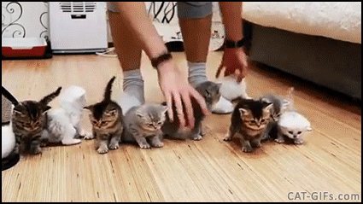
Maintaining randomisation
Contamination / Spillover
“We visited a job center to say hi. They were running the intervention on the control group, thinking they were doing a good thing by practicing.”
“We were trying to get office workers to use standing desks. A manager noticed the control arm wasn’t using them and was about to send out an encouraging email.”
Randomisation is easy to do, but hard to maintain
Notes:
PURPOSE:
Identify unit of randomisation
KEY MESSAGE:
In other words, you need to ask yourself - what is the right ‘unit’ of randomisation.
And one of the keys here is to reduce the risk of contamination.
Contamination happens when the control group receive treatment. I alluded to this before in the hypothetical example in which kids and parents talk to other kids and parents about the text messages they receive from their school.
Contamination happens if your treatment group talking to your control group - the control group may end up exposed to the intervention
Think about what kind of situations might your treatment group talk to your control group and thereby cause spillover
(Bad) Criminology: Increased enforcement may displace crime to nearby areas.
(Good) Education: Students may share newly acquired knowledge with friends.
(Good) Public Health: Providing an infectious disease vaccine to some individuals may decrease the probability that nearby individuals become ill.
TIMING:
1 minute

Slide 83
Randomisation – ‘Cluster level’
Notes:
PURPOSE:
Introduce cluster RCTs
KEY MESSAGE:
When your unit of randomisation is no longer an individual, but a set of actors, a community or region, you are now running what is called a clustered RCT.
There are several circumstances in which cluster randomised trials are appropriate and may be chosen over other randomised designs. Some interventions are by their nature meant to be applied to whole communities rather than individual people such as educational programs or improving water supplies in villages. In some circumstances, cluster randomisation offers more logistical convenience or would be received with greater acceptability when delivered to the entire population rather than at individual level.
Cluster randomised trials are also an effective way to avoid contamination and this is one of the most common reasons for adopting this design.
TIMING:
1 minute

Slide 84
Randomisation – Individual vs. Cluster
Unit of Analysis
Individual
Cluster (e.g. School, Village, Office)
Advantage
Smaller sample required to detect an effect.
Reduces spillover effects
Often more palatable
Disadvantage
Spillovers undermine trial.
Need more people to detect the same effect size
Notes:
PURPOSE:
Disadvantages of cluster RCTs
KEY MESSAGE:
However, these advantages needs to be weighed against the limitations.
Chief among these is that the more you cluster, the more you reduce the likelihood of randomising in a way that ensures characteristics on the study groups are similar. So typically, you need more people to be involved in the trial, which comes at a cost.
TIMING:
1 minute

Slide 85
What if everyone must get the intervention at some point?
Introducing stepped wedge trials.
Notes:
PURPOSE: Stepped-wedge trial
KEY MESSAGE: Cluster RCTs also enable you to offer the intervention to everyone, but running what’s called a ‘stepped-wedge trial’.
The way this works is that everyone receives the intervention, but at different time periods.
This helps you get mitigate fears of unfairness where one group receives the intervention, but another doesn’t.
However, by their nature stepped-wedge trials take longer to run, and are therefore more costly.
TIMING:
1 minute

Slide 86
Key steps of an RCT
Plan the intervention
2. Determine the outcome
3. Decide unit of randomisation
(eg individuals, institutions or geographical areas)
4. Power Calculations
(How many units – people, institutions, or areas - are required for a robust result?)
5. Random assignment
6. Implement intervention
Notes:
PURPOSE:
Introduce concept of power
KEY MESSAGE:
A fourth and absolutely critical step is to ensure that have enough statistical power to be able to determine, with a high level of confidence, whether your intervention has had an effect.
TIMING:
1 minute

Slide 87
How Do I Know If My Sample is Big Enough?
You need enough data to know what you’re looking at.
28 data points?… nope!
Notes:
PURPOSE:
Introduce concept of power
KEY MESSAGE:
A fourth and absolutely critical step is to ensure that have enough statistical power to be able to determine, with a high level of confidence, whether your intervention has had an effect.
Statistical power is the probability that the test correctly rejects the null hypothesis. In other words, it is the probability of finding a true positive result and not a false positive. Clearly, when running a trial you want to be confident that if you observe a positive result, it really is due to a change in behaviour.
So how can you get this statistical power, which enables you to be confident in your results.
Above all, you need to make sure your sample is big enough.
Your sample needs to be large enough so that you know what you’re looking at.
Simple illustration on screen
TIMING:
1 minute

Slide 88
How Do I Know If My Sample is Big Enough?
You need enough data to know what you’re looking at.
84 data points?… nope!
Notes:
PURPOSE:
Introduce concept of power
KEY MESSAGE:
Still not clear
TIMING:
10 seconds

Slide 89
How Do I Know If My Sample is Big Enough?
You need enough data to know what you’re looking at.
828 data points?… Maybe!
Notes:
PURPOSE:
Introduce concept of power
KEY MESSAGE:
If you were comparing a puppy and a banana you could probably stop here
You have enough granularity to know what you’re looking at
However - If you wanted to know had your intervention increased the number of puppies wearing scarfs you’d need more data
TIMING:
10 seconds

Slide 90
How Do I Know If My Sample is Big Enough?
You need enough data to know what you’re looking at.
8,000 data points… Hello, puppy!
Notes:
PURPOSE:
Introduce concept of power
KEY MESSAGE:
Enough to detect what is going on
TIMING:
10 seconds

Slide 91
How Do I Know If My Sample is Big Enough?
You need enough data to know what you’re looking at.
237,777 data points… too much data... but you’re welcome!
Notes:
PURPOSE:
Introduce concept of power
KEY MESSAGE:
Too much!
TIMING:
10 seconds

Slide 92
How Do I Know if the Difference is Significant?
Product 1
2,777
Power refers to the ability that your evaluation has to detect a ‘true’ effect
Product 2
2,777
Notes:
PURPOSE:
Importance of large sample size
KEY MESSAGE:
Applying this to power, power refers to the ability that your evaluation has to detect a ‘true’ effect.
The larger the sample size, the more likely you are to understand whether there is a “real” difference.
So in this case we can be pretty confident that we have found a true positive - that product 2 truly is better than product - because of the amount of reviews.
Even if the difference is only half a star, there are so many reviews that we can be pretty confident that Product 2 is better than Product 1.
TIMING:
30 seconds

Slide 93
How Do I Know if the Difference is Significant?
Product 1
2,777
Which product would you go for?
Product 2
2,777
Notes:
PURPOSE:
Importance of large sample size
KEY MESSAGE:
The larger the sample size, the more likely you are to understand whether there is a “real” difference.
Amazon example, lots of reviews so easy to select product 2
TIMING:
30 seconds

Slide 94
How Do I Know if the Difference is Significant?
Product 1
21
Are you as sure as you were before?
Product 2
21
Notes:
PURPOSE:
Importance of large sample size
KEY MESSAGE:
To illustrate this point further, image each product now only had 21 reviews.
How sure could you be that Product 2 is better?
Applied to an intervention, we would have much less statistical power, and so we could be much less certain that our intervention had had an effect.
TIMING:
30 seconds

Slide 95
How Do I Know if the Difference is Significant?
Product 1
21
The more data you have, the more certain you can be.
Product 2
21
Notes:
PURPOSE:
Importance of large sample size
KEY MESSAGE:
To illustrate this point further, image each product now only had 21 reviews.
How sure could you be that Product 2 is better?
Applied to an intervention, we would have much less statistical power, so if we saw small differences between our intervention and control group, we could be much less certain that our intervention had had an effect.
TIMING:
30 seconds

Slide 96
How Do I Know if the Difference is Significant?
Product 1
21
Now which product would you go for?
Product 2
21
Notes:
PURPOSE:
Impact of large effect sizes
KEY MESSAGE:
But if you observed a huge difference between the intervention and control group, a small sample might suffice.
In this case, you’d be pretty confident than Product 2 was better than Product 1.
When there is a big difference between reviews, we do not need as many reviews to know the ‘real’ difference in product rating. However, when there is only a small difference and a low number of reviews, it is harder to know the ‘real’ product ratings.
TIMING:
30 seconds

Slide 97
How Do I Know if the Difference is Significant?
Product 1
2,777
Unless the difference is big, the best way to be certain of the ‘real’ product rating is to have a big sample.
Product 2
2,777
© The Behavioural Insights Team
Notes:
PURPOSE:
Impact of large effect sizes
KEY MESSAGE:
But for the most part, unless the difference is big, the best way to be certain of the ‘real’ product rating - or to detect differences between your intervention and control group - is to have a big sample.
TIMING:
30 seconds

Slide 98
Key steps of an RCT
Plan the intervention
2. Determine the outcome
3. Decide unit of randomisation
(eg individuals, institutions or geographical areas)
4. Power Calculations
(How many units – people, institutions, or areas - are required for a robust result?)
5. Random assignment
6. Implement intervention
Notes:
PURPOSE:
Introduce section on randomisation
KEY MESSAGE:
Having conducted power calculations, you’ll now know how big your sample needs to be for you to be confident of detecting impact when it occurs.
With your sample convened, the next step is to randomly assign into a treatment and control group
TIMING:
30 seconds

Slide 99
Randomise – similar as possible
= sub group of interest
Notes:
PURPOSE:
Benefits of randomisation
KEY MESSAGE:
The beauty of randomisation is that if our sample is large enough, our control and treatment group should end up similar characteristics.
So if you imagine that that there were a substantial number of people on this call - say 1,500 - and I randomised you into group 1 and group 2, chances are the two groups would end up looking pretty similar.
On average you would be very similar across a number of dimensions. You would have a similar average level of education, a similar average level of age, a similar average salary, similar average height, similar average weight.
TIMING:
30 seconds
Familiar with randomisation now, but there are some ways to ensure your randomisation has good balance
e.g. Stratification – randomise within sub-groups of interest
Always good to check balance after randomising to confirm that your groups are similar
Different types of trials require different randomisation approaches
E.g. what if you have to wait for people to enter your system/trial?
(E.g. speeding offences) – changing letters, etc.
day of the week
use ID numbers (odd/even)

Slide 100
How do I know if my groups are balanced?
Random assignment means that every individual (or household / business etc) in your sample has exactly the same odds of being assigned to the treatment or control group. It’s a matter of random chance.
By balanced we mean the groups should be just about the same in terms of characteristics that might affect your outcome:
For things you can measure, e.g., how many women / university-educated people in each group
But also things you can’t easily measure, e.g., how many shy or motivated people in each group.
Notes:
Their assignment to a particular group isn’t any more or less likely because of where they live, how old they are, how educated they are, or anything else. It’s a matter of random chance.
Law of large numbers - as a sample size grows, its mean gets closer to the average of the whole population
https://commons.wikimedia.org/wiki/File:(1186x2368)_Law_of_Large_Numbers.gif

Slide 101
Small samples can lead to imbalance
Take a coin
Flip it 10 times
Record your result (Heads:Tails)
I will document the results
Note what happens to the overall average number of heads as the sample size increases
Notes:
Spreadsheet to do this activity: https://docs.google.com/spreadsheets/d/1c3kWFRR4Wg_aH3VOZbcHtEJTjNm9uocH4aiC3fsdSzk/edit?usp=sharing
Law of large numbers - as a sample size grows, its mean gets closer to the average of the whole population
https://commons.wikimedia.org/wiki/File:(1186x2368)_Law_of_Large_Numbers.gif

Slide 102
Imbalance can be created by trial design
The control group will be everyone who walks into the jobs office before noon, the treatment group will be everyone who walks in later.
No! That could create selection bias.
The control group will be everyone with first letter of first name starting A-M, the treatment group will be everyone else.
Probably not - some cultures are more likely to have names beginning with certain letters than others, so certain cultures may be more likely to end up in your treatment group than others.
The control group will be everyone with a even-numbered address, the treatment group will be everyone else.
Maybe! Proceed with caution. Addresses aren’t randomly assigned; is there something about your intervention that could be impacted by the same factors that go into address assignment?
The control group will be everyone assigned a “0” by a random number generator and the treatment group will be everyone assigned a “1.”
Yes! You are good to go.
Notes:
PURPOSE:
Introduce section on randomisation
KEY MESSAGE:
But what do we mean by ‘random’ assignment?
We might think we’re being random, but if our approach is not truly random, we can create imbalances in the two groups.
I’m going to show you three approaches to randomisation that could create imbalance, and I want you to tell me why.
1 - The control group will be everyone who walks into the jobs office before noon, the treatment group will be everyone who walks in later.
2 - The control group will be everyone with first letter of first name starting A-M, the treatment group will be everyone else.
3 - The control group will be everyone with a even-numbered address, the treatment group will be everyone else.
→ In many cases the simplest approach is the best - use a random number generator to assign the treatment group with the number 0, and the control group with the number 1.
Again, if our sample is large enough, we should come out with two groups that are statistically similar
TIMING:
1 minute

Slide 103
Key steps of an RCT
Plan the intervention
2. Determine the outcome
3. Decide unit of randomisation
(eg individuals, institutions or geographical areas)
4. Power Calculations
(How many units – people, institutions, or areas - are required for a robust result?)
5. Random assignment
6. Implement intervention
Notes:
PURPOSE:
Introduce implementation
KEY MESSAGE:
With your trial design and your control group and treatment group allocated, it’s now time to implement the intervention in accordance with the plan you’ve made.
TIMING:
30 seconds

Slide 104
Implementation – Be supportive...
Notes:
PURPOSE:
Reinforce message that you need to work closely with implementation partner
KEY MESSAGE:
The key here is to work closely with and be supportive of your implementation partner.
Remember, it is often not you who will be implementing the intervention. You might have designed the trial, but it will often be another team, agency or department who implements the intervention on a day to day basis and who provides you with the data you need to measure impact. For example, if you’re working with schools, it might be teachers who are implementing the intervention that you have designed.
Be on hand to support if things go wrong
Sometimes things will not go according to plan, because they often will, and you will need to adapt accordingly.
Something that is worth considering is trying to do a soft launch or pilot in a different group to get first hand experience of the mechanics of the project.
TIMING:
30 second

Slide 105
...and check-in
Drop-in on delivery
Ask for an early cut
of the data
Notes:
PURPOSE:
Continuation..#7 tip - Agree who does what and when...
KEY MESSAGE:
And be sure to check in on implementation partners to make sure the trial is being delivered as you had planned.
Go to where the implementation is being delivered and see for yourself that it is being rolled out as envisaged
Schedule regular catch-ups with partners - weekly → fortnightly → monthly depending on timelines and pressure.
Asked for an early cut of data to make sure it is being collected as you had planned.
EXAMPLE 1 - important to check in early in delivery process
“We ran a letter trial to inform householders of a scheme to insulate their homes. The research person by mistake duplicated the data before randomisation. A proportion of the letters were sent each day. We noticed a few days in and saved the rest of the results. People that received two letter were most likely to respond though!”
EXAMPLE 2 - On next slide
TIMING:
2 min
LINK TO:
Next slide

Slide 106
Example: “Interim results” vs “Sneak peek”
Notes:
PURPOSE:
Continuation from previous slide...showing example
KEY MESSAGE:
A brief aside on when to look at results - or rather when not to…
So imagine a situation where you’ve been commissioned to conduct a trial over 18m - and you’re pre-specified that the trial analysis is at the 18m point.
In autumn a few months after starting the funder suddenly gets the urge to see some interim results -- like REALLY keen.
What’s the worst that could happen, right!?
Don’t have the data you need to be able to report results
You over-analyse and declare the project a failure or success prematurely
TIMING:
2 min

Slide 107
Common pitfalls implementing RCTs
Pre-launch
Data access issues
Data collection issues
Outcome measure unclear
Can’t match individuals to treatment/control
Attrition
Negative effects
Delivery
Data collection/ analysis
Randomisation failure (last min additions/”random” not random)
Tech solution not working
Intervention sent to the wrong people
Poor delivery
Low recruitment/low participation
Complaints
Spillovers / comms between groups
Process change
Director cancels
Intervention watered down
Unable to measure what you wanted
Notes:
PURPOSE:
Round up some of the pitfalls
KEY MESSAGE:
Trials can be affected by a number of pitfalls, so during this planning stage it’s also important to think about what could go wrong, and try mitigate.
These can occur at all stages of a trial.
Prior to its launch, your partner may withdraw, or you may realise that you can’t get the data you need to measure what you want.
During delivery, you may struggle to recruit participants, experience contamination whereby the control group also receives the intervention, or your intervention may not be delivered effectively by the project partner.
When analysing the results, you may struggle to get hold of the data you need, realise that a lot of people dropped out of the trial, or find that the trial have a negative effect.
“At each stage, what do we need to consider? What pitfalls can be avoided?”
EXAMPLES:
Process change
Email no longer used - About to deliver an email trial with a technical college in Singapore, when the college stopped using email completely and moved to an internal message system for students. Messages had to be sent by teachers (who would have to individually agree), and couldn’t be randomised by students. The effects on power and practicality were too big, and the trial was stopped.
Complaints
Phishing trial - we were sending phishing emails to our project partner to see how many people gave their details, but those at the top of our partner org weren’t properly informed. Our emails were identified as phishing and a warning email went around the whole org, significantly reducing our outcome measure!
Data wasn’t collected
Transmitted to non-existent bluetooth device - KCL were collecting attendance at a “Study Abroad” event by scanning uni cards. The scanners had a bluetooth option that, when switched on, meant they didn’t store any data - they shared it with a connected bluetooth device (or sent it into the ether if there wasn’t one). We lost all the data. Sad times.
Randomisation
Sometimes you have missing data in a randomisation - e.g. schools without previous GCSE results because they’ve changed name or merged. So - what do you do? You can randomly assign them values or you can treat “missing” as a group and allocate within it.
TIMING:
3 minutes

Slide 108
Other impact evaluation methods
Method | Plain-language description
Linear regression | Finding a line of best fit
Differences-in-differences | Comparing changes across groups (the first ‘difference’) over time (the second ‘difference’)
Regression discontinuity | Comparing groups just above and below some threshold
Notes:
Goal of today is not to go through each of these (but BIT runs evaluation training too)Another important point that is easy to forget: you can just ask people!
Note rainfall IV example in EOHO paper: e.g. eating out correlated w virus cases but could be due to selection or other OVB; rainfall correlated w eating out but uncorrelated w virus

Slide 109
There will be unknown unknowns
Notes:
PURPOSE:
Finally, there will be unknowns
KEY MESSAGE:
“Donald Rumsfeld, American former politician said this quote. There are also unknown unknowns—the ones we don't know we don't know.
There’s always stuff no one can see coming. True of trials and true of policies.
Be optimistic, stay calm”
EXAMPLE:
“We tried to text parents when kids were not doing their homework. We did a prototype and everything worked in practice. When we went live, I noticed I had 4,000 emails. The school had an old software so the text went to every kid. We sorted it and it was fine. We were testing a new software. Then you get an ear full and they will actually be a great resource to ask them about their thoughts on your trial” -Raj Chande
TIMING:
1 min

Slide 110
Assessing external validity requires new evidence and a focus on people
Source: J-PAL, ‘The Generalizability Puzzle’, p. 57
Notes:
In this case: ‘what will happen’

Slide 111
Trial phase
TARGET
EXPLORE
SOLUTION
TRIAL
SCALE
Phases
Develop a strategy to assess if the results you observe are due to your intervention or not and evaluate the effectiveness of your intervention.
Notes:
PURPOSE
Set up Trial
KEY MESSAGE:
Crucial to test interventions because, as we’ve previously established, context is key. We need to properly test and evaluate interventions because sometimes they do nothing and sometimes they backfire.
Now you will develop a strategy to analyse the results to see if the intervention changed any behaviours.
TIMING:
1-2 mins
LINK:
To next slide

Slide 112
Activity: Discuss and plan an evaluation strategy
15 mins
Checklist Item
1. What outcome are you measuring?
2. What is your sample size?
3. How will you know what would have happened if you hadn’t intervened?
4. Is the comparison group similar to the group receiving the new approach?
5. How will you keep your control and treatment group separate?
6. What external factors could impact results?
7. Can you explain why you are having an impact?
Instructions
Use the Activity 8 tab in your workbook to plan how you would evaluate your solution
Resist jumping straight to ‘we’ll obviously do a randomised-controlled trial’ — this might not be the best answer
It’s okay to have many unanswered questions or even no clear method: recognising the key factors in an evaluation and being able to discuss them is more important than having a concrete design
Notes:
PURPOSE
Explain the key things to consider when planning an evaluation
KEY MESSAGE:
The first thing is to make sure that you’re clear on the outcome you’re measuring
The next thing is to consider your sample size
Then you need to think about how you’re know what would have happened if you had done nothing
How will you ensure your groups don’t differ in some fundamental way?
If you have a control group, how will you keep it separate from your treatment group?
What external factors could impact the results?
What is the key ingredient of your intervention that is driving the change in behaviour? Will you be able to scale this beyond the trial?
TIMING:
5 mins
LINK:
To next slide

Slide 113
Presentation Prep

Slide 114
Activity: Prepare for your presentation
30 mins
Key points to cover;
The challenge you’re addressing
The key behaviours you identified as important (look back at your behaviour map)
The barriers you identified as important (think back to the barrier cards you selected)
You solution / intervention (what EAST principles have you applied)
How you plan to test the effectiveness of this solution
Use your workbooks to help guide this presentation (See the Activity 9 tab for a format to help plan your presentation)
You are allowed to share your screen (e.g. the Activity tab) and can use one slide to aid your presentation if you would like
You will have a maximum of 5 minutes to present followed by 1-2 questions

